Slide 1


Hadronic B Decays at Belle
Tristan Bloomfield
On Behalf of Belle Collaboration
2019/09/18
Notes:
Report on recent results from studies of hadronic B decays at Belle

Slide 2
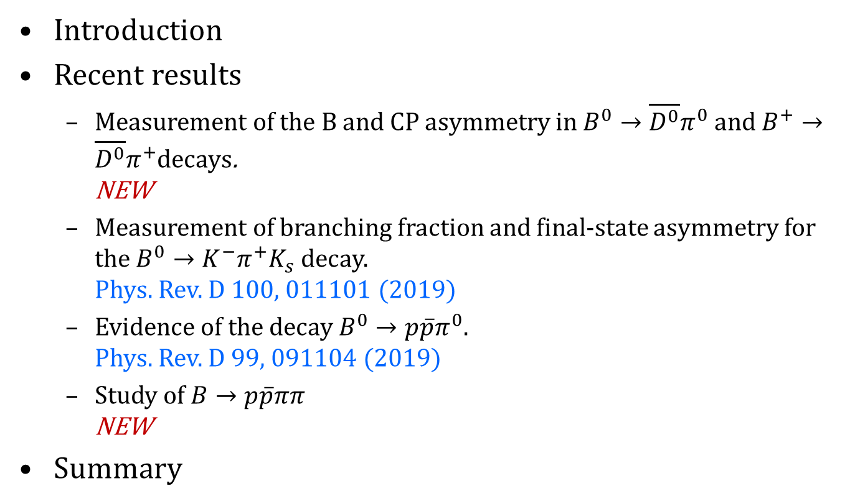
Contents
Introduction
Recent results
  Measurement of the B and CP asymmetry in $B^{0}→\overline{D^{0}}π^{0}$ and $B^{+}→\overline{D^{0}}π^{+}$decays.
  NEW
  Measurement of branching fraction and final-state asymmetry for the $B^{0}→K^{−}π^{+}K_{s}$ decay.
  Phys. Rev. D 100, 011101 (2019)
  Evidence of the decay $B^{0}→p\overline{p}π^{0}$.
  Phys. Rev. D 99, 091104 (2019)
  Study of $B→p\overline{p}ππ$
  NEW
Summary
Notes:
Start with a brief overview.
Present 4 results, 2 recently published: B0 to K pi K short and B0 to p p bar pi0
2 new preliminary results, B to D0 bar pi and B to p p bar pi pi

Slide 3
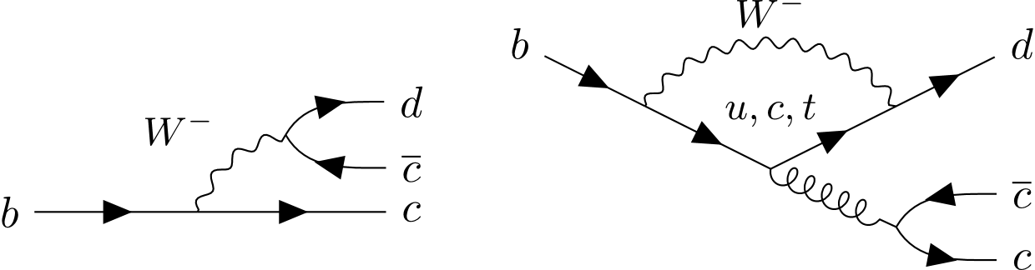










Direct CP Violation
Direct CP violation when $|A\left(f\right)|≠\overline{|A}\left(\overline{f}\right)|$
$φ_{1,2}$ CP violating weak phase (CKM)
$δ_{1,2}$ CP invariant strong phase (differing mechanisms)
$A_{CP}\left(P→f\right)≡\frac{Γ\left(P→f\right)−Γ\left(\overline{P}→\overline{f}\right)}{Γ\left(P→f\right)+Γ\left(\overline{P}→\overline{f}\right)}∝\sin{{(φ}_{1}−φ_{2})}\sin{{(δ}_{1}−δ_{2})}$
$∴$Need possesses with both strong and weak phase difference.
$$A_{1}={|a}_{1}|e^{i\left(δ_{1}+φ_{1}\right)}$$
$$\overline{A_{1}}={|a}_{1}|e^{i\left(δ_{1}−φ_{1}\right)}$$
$$f$$
$$CP$$
$$\overline{A}$$
$$\overline{f}$$
$$A$$
$$A_{2}={|a}_{2}|e^{i\left(δ_{2}+φ_{2}\right)}$$
$$\overline{A_{2}}={|a}_{2}|e^{i\left(δ_{2}−φ_{2}\right)}$$
Notes:
Quick look at direct CP violation.
For this to occur a decay needs to be the sum of at least two processes with a magnitude and 2 phases.
From the CKM terms, a CP violating weak phase with differing signs between conjugate decays.
And a CP invariant strong phase that stays the same, and occurs as a result of different decay mechanisms.
Quantify the CP violation of a decay by Acp, which for such a decay we find this is proportional to sin of difference in weak phase times sin of different in strong phase.
So we need both a weak and strong phase difference to get direct CP violation.

Slide 4
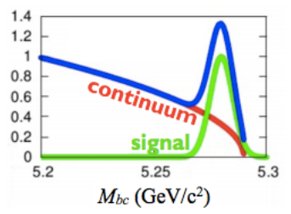
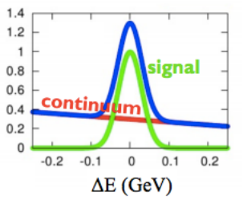
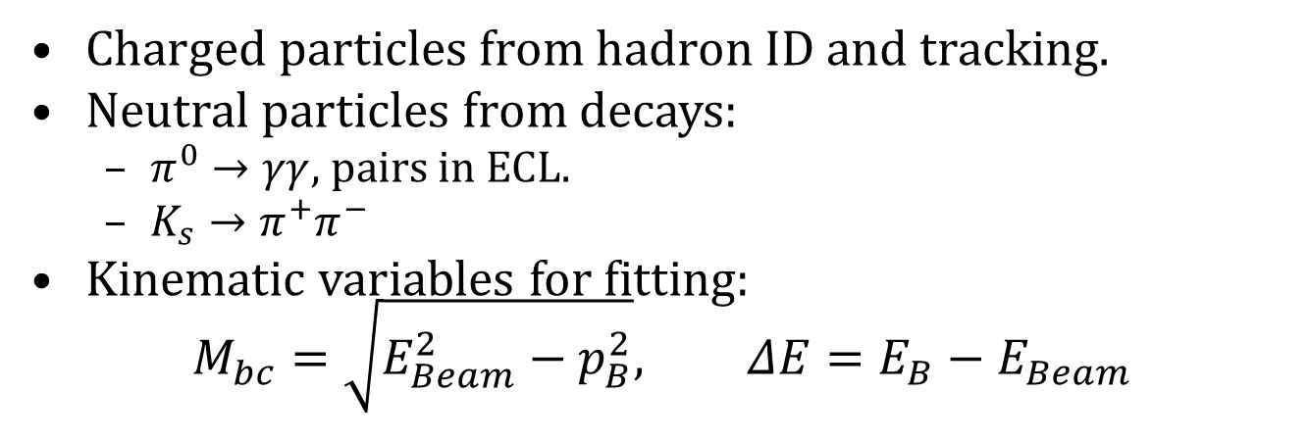
Signal Reconstruction
Charged particles from hadron ID and tracking.
Neutral particles from decays:
  $π^{0}→γγ$, pairs in ECL.
  $K_{s}→π^{+}π^{−}$
Kinematic variables for fitting:
$M_{bc}=\sqrt{E_{Beam}^{2}−p_{B}^{2}}, ΔE=E_{B}−E_{Beam}$
Notes:
Using charge tracks detected by the CDC, particle ID system uses information from the Aerogel Cerenkov Counter, the time of flight and the rate energy is deposited in the CDC to identify charged particles.
Pi0s are identified by their decay in gamma gamma, which we detect as close-together trackless clusters in the ECL.
K_s detected by their decay to pi+ pi- pairs, with fitted vertex.
The primary kinematic parameters we use to fit to are:
Beam contrained mass: peaks at B mass for full reconstructed B
And Delta E: peaks at 0 for full reconstructed B

Slide 5
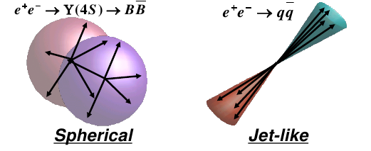
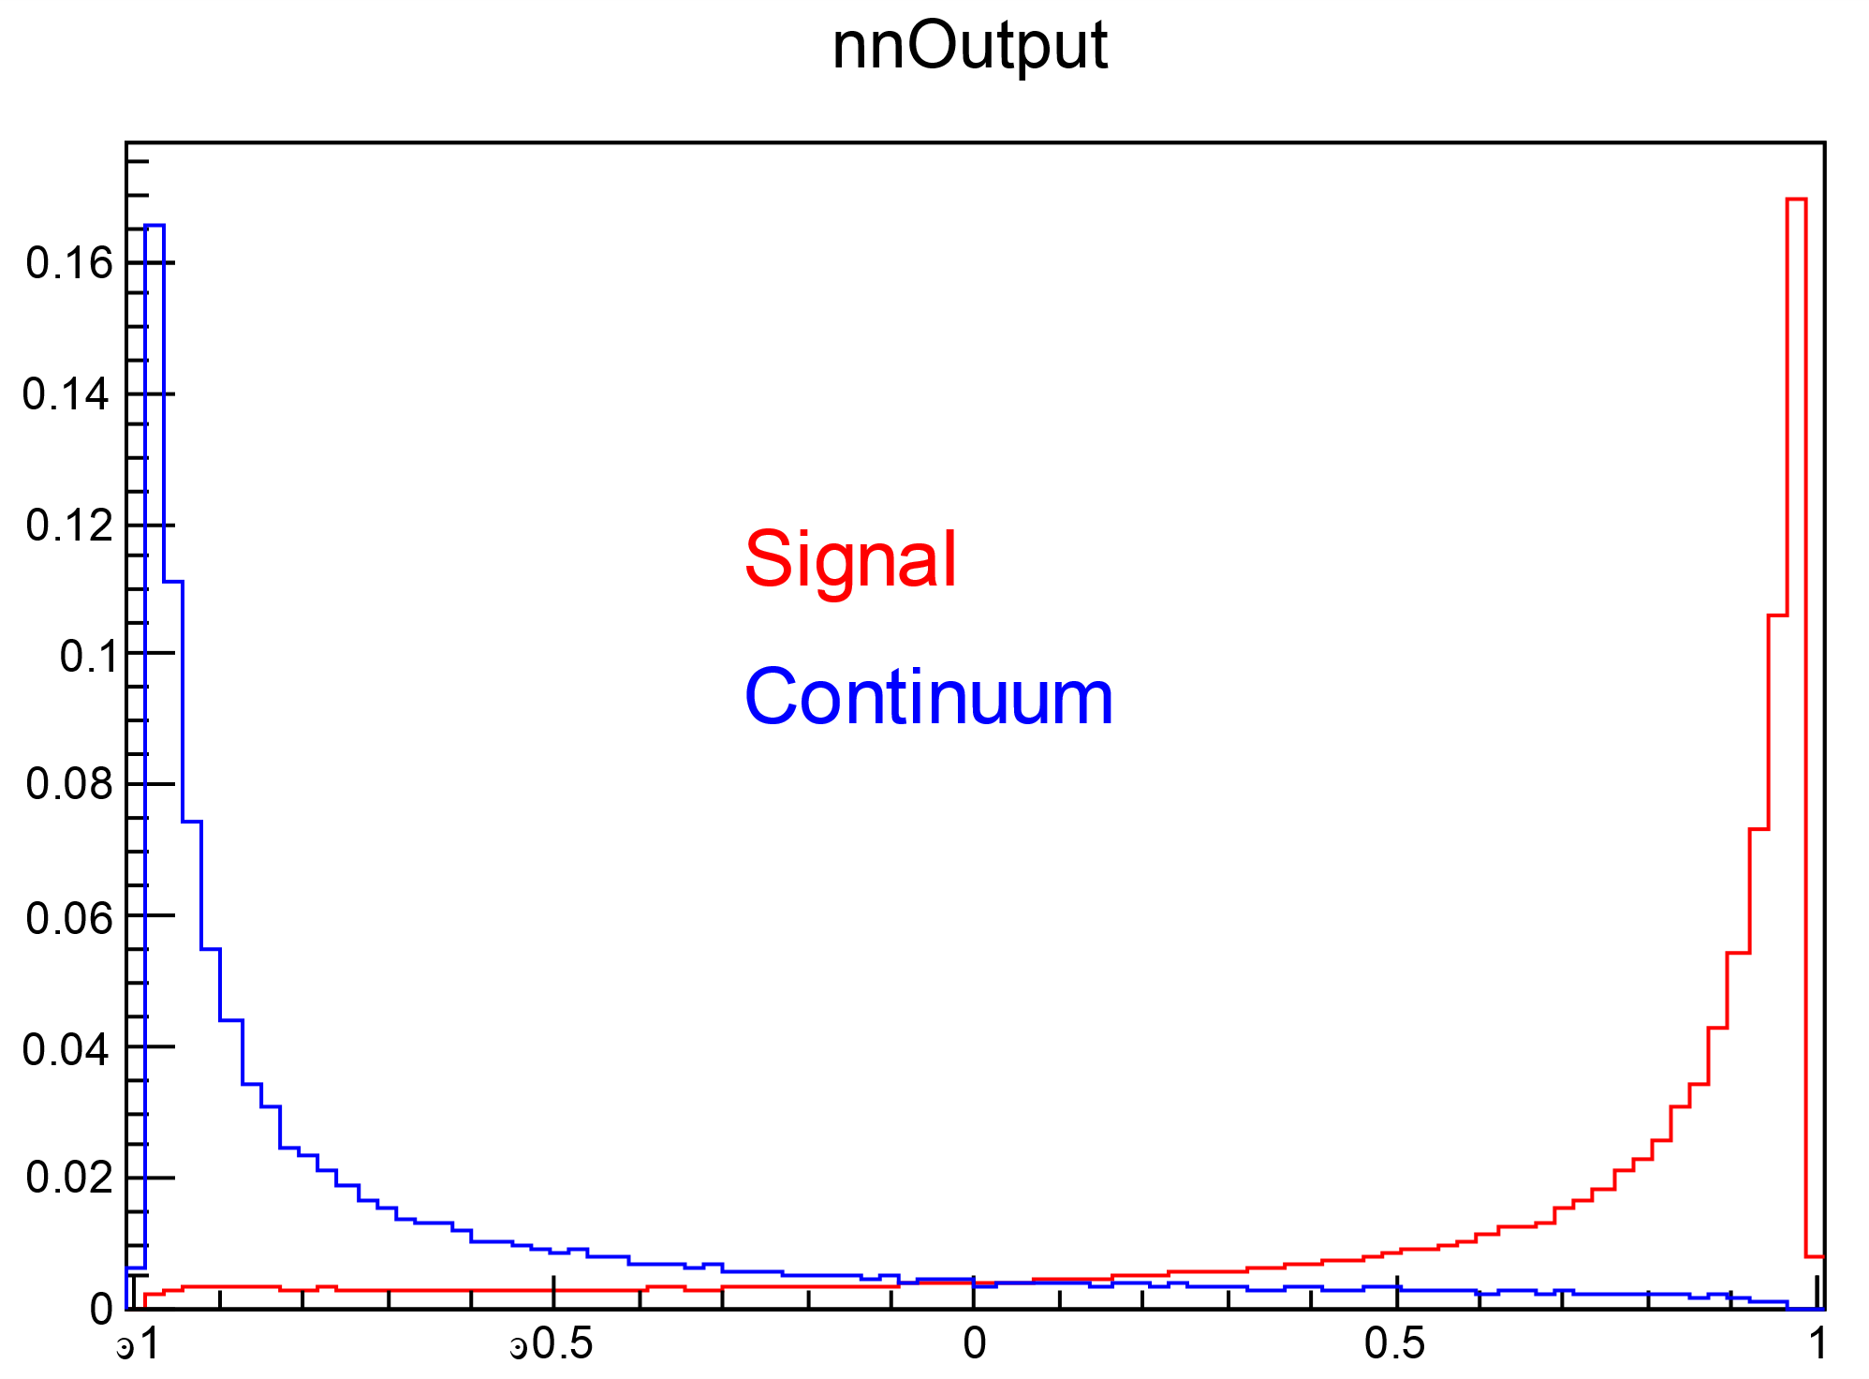
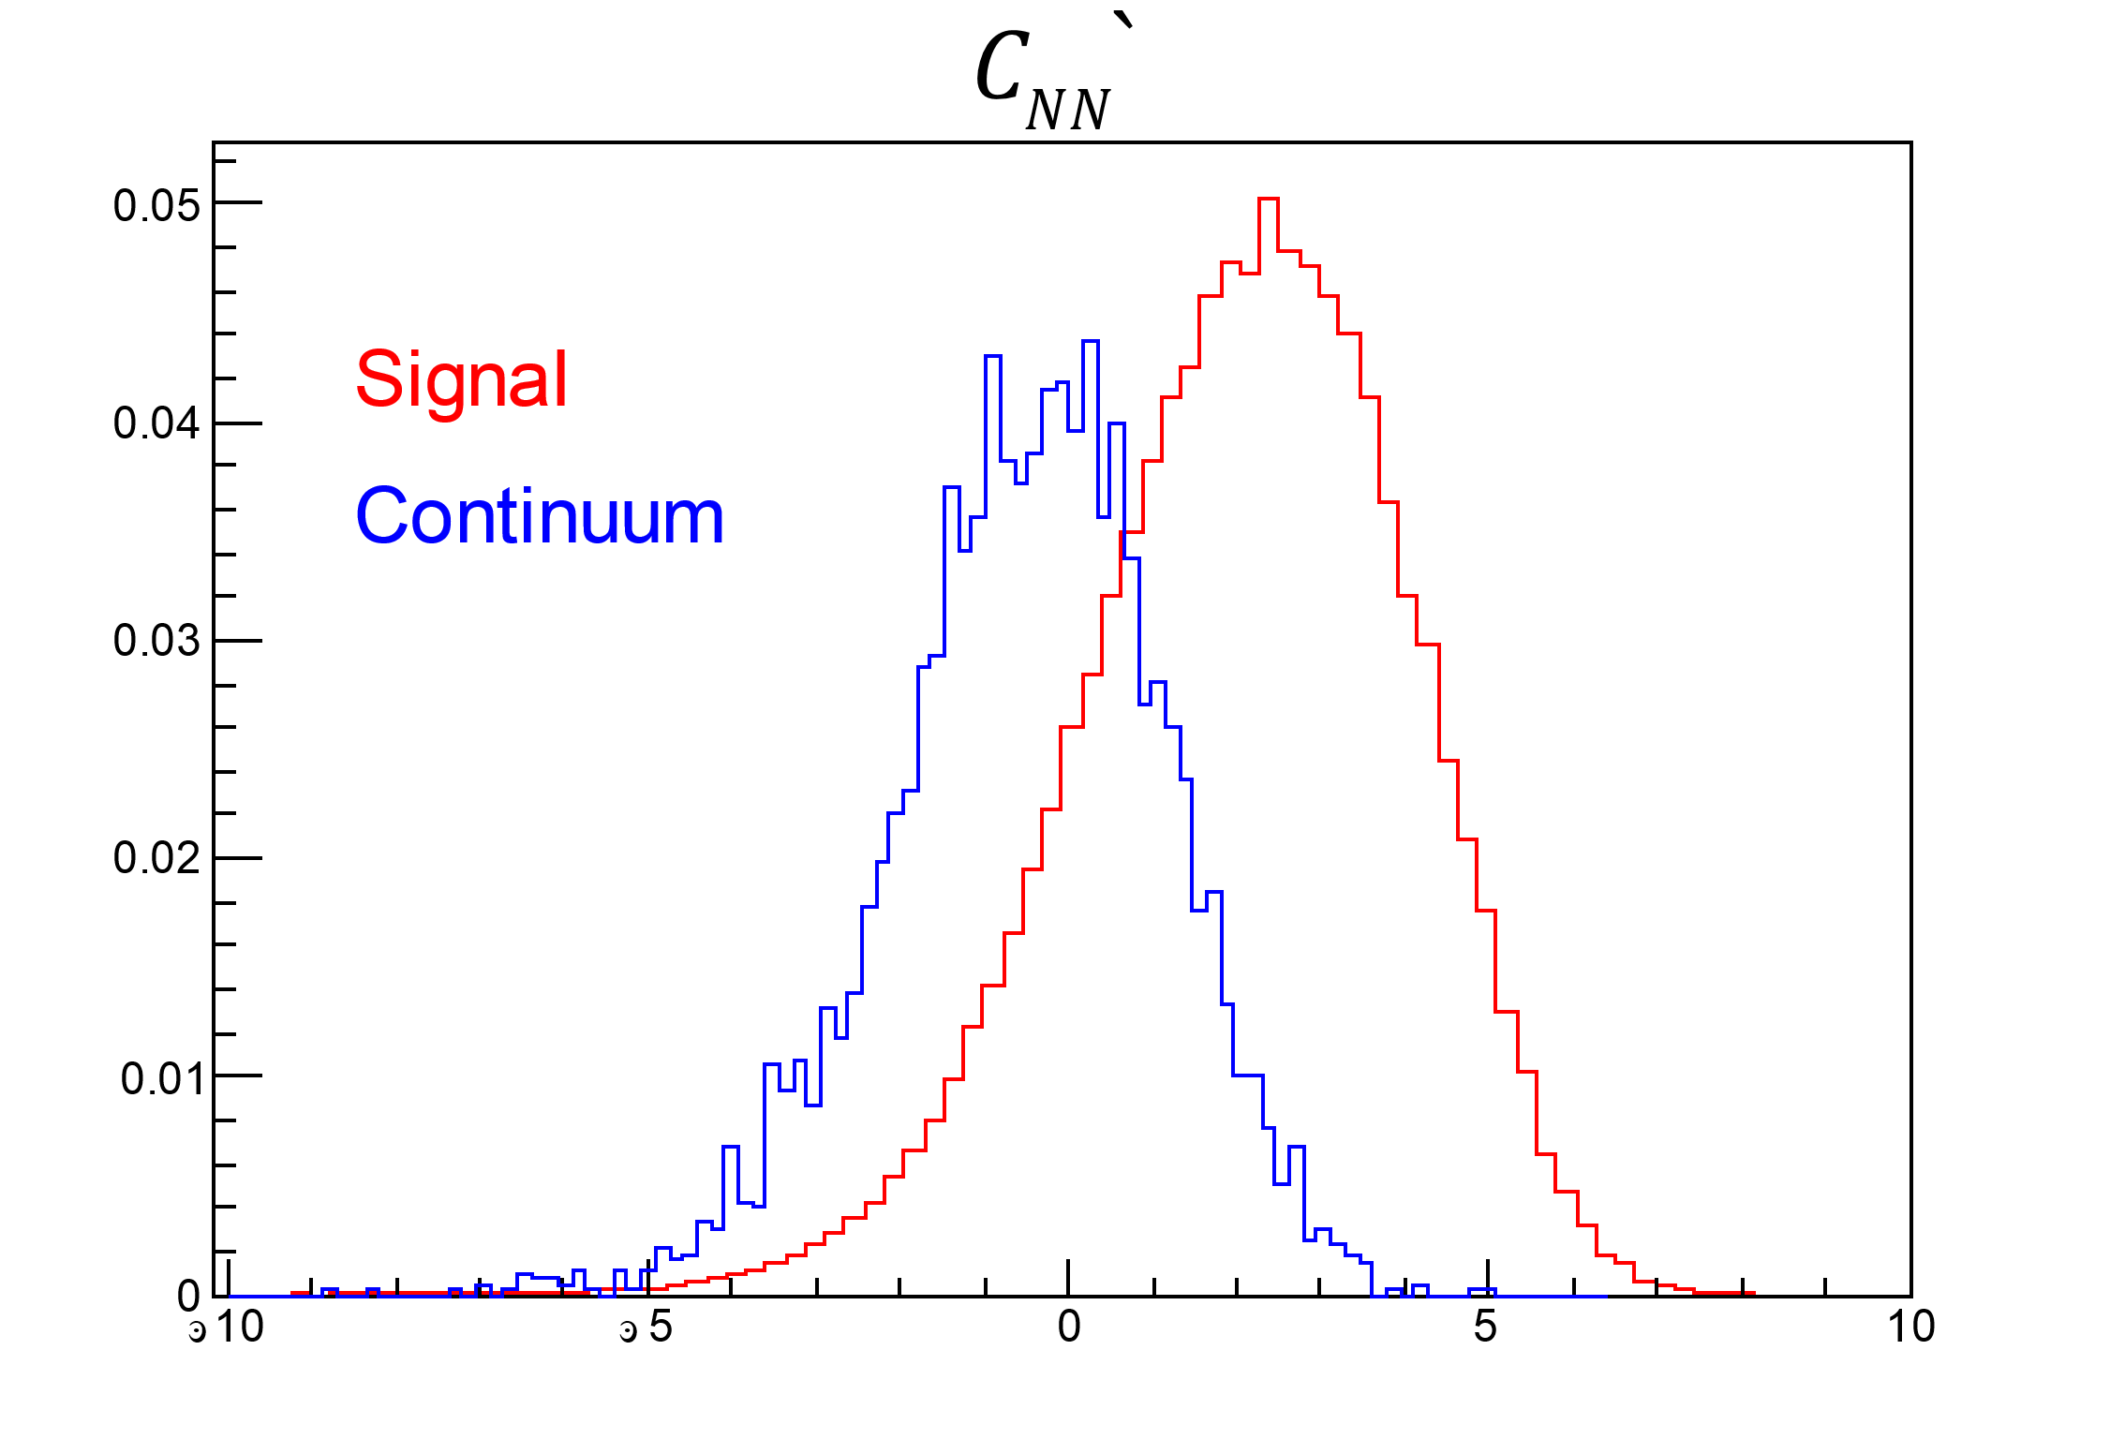
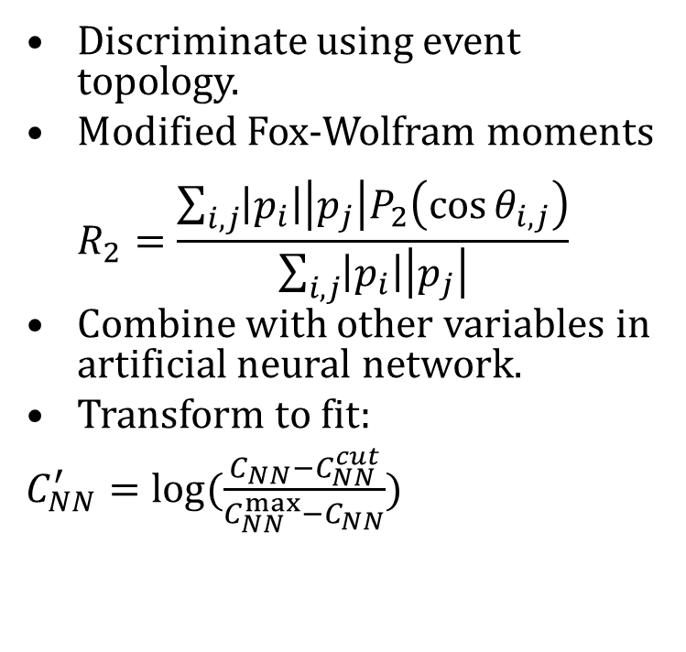

Continuum Suppression
$e^{+}e^{−}→q\overline{q} (q∈u,d,s,c)$ dominant background.
~3 times $e^{+}e^{−}→Υ\left(4S\right)$ cross-section.
Discriminate using event topology.
Modified Fox-Wolfram moments
$R_{2}=\frac{\sum_{i,j}{\left|p_{i}\right|\left|p_{j}\right|P_{2}\left(\cos{θ_{i,j}}\right)}}{\sum_{i,j}{\left|p_{i}\right|\left|p_{j}\right|}}$
Combine with other variables in artificial neural network.
Transform to fit:
$C_{NN}^{′}=\log{(\frac{C_{NN}−C_{NN}^{cut}}{C_{NN}^{max}−C_{NN}}})$
$$C_{NN}^{cut}$$
Notes:
q q bar continuum is our largest source of background events.
Primary way to distinguish between BB and continuum is the events shape.
qq are produced with high momentum, and decay as back to back jets.
While BB pairs are produced with close to 0 momentum (in the centre of mass frame), so their decay products will have a roughly spherical uniform distribution
Primary way we define what sort of topology is with Fox-Wolfram moments.
Combine with a number of other variables in a neural network.
Transform to use in fit.

Slide 6
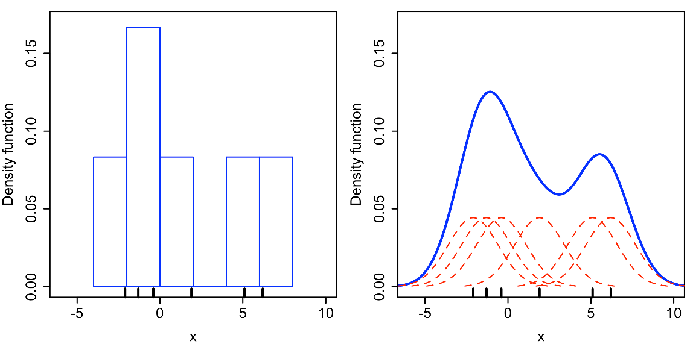
KEST PDF for 2D MC based models
Kernel density estimation models dataset by superposition of kernel function (Gaussian) for each datapoint.
Use adaptive bandwidth to adjust Gaussian width based on local event density.
Retains information in high density areas while smoothing low density.
Notes:
Number of these studies have recently used kernel density estimations instead of histograms as non-parametric PDFs for correlated variables.
Similar to histograms, but instead of binning data, each point is represented by a kernel function that superimpose to form a PDF.
Roofit uses an algorithm to dynamically vary the bandwidth based on the local event density.
This means when event density is high and uncertainty low information is retained, while low density areas with high uncertainty are smoothed to reduce statistical noise.

Slide 7
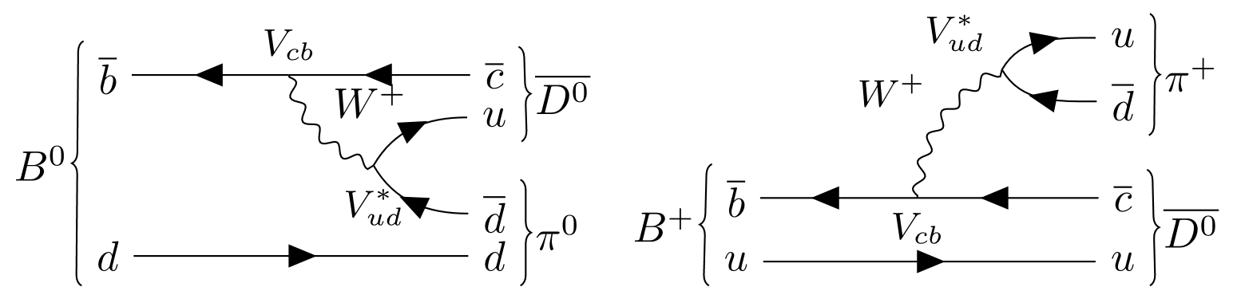
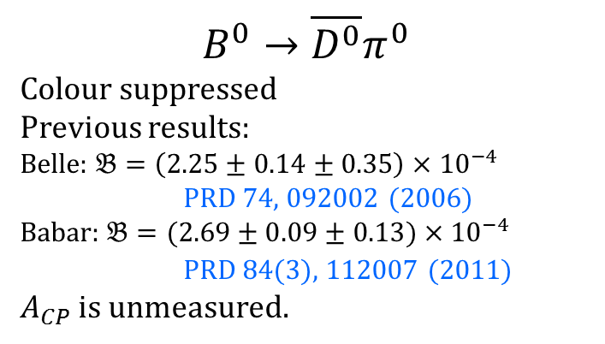
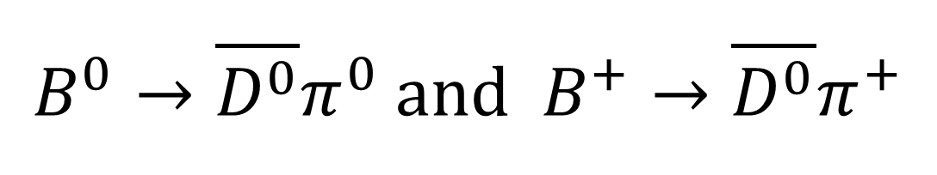
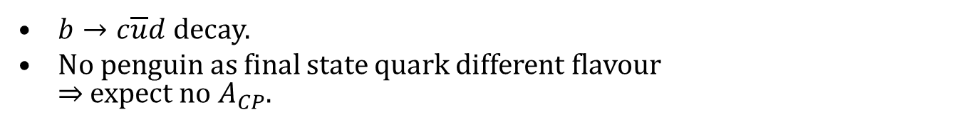
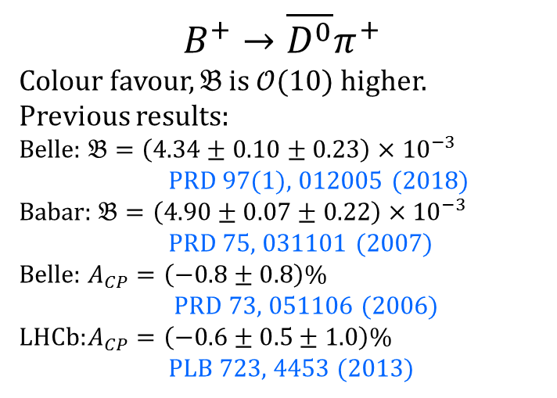
$B^{0}→\overline{D^{0}}π^{0}$ and $B^{+}→\overline{D^{0}}π^{+}$
Preliminary
$b→c\overline{u}d$ decay.
No penguin as final state quark different flavour
$⇒$ expect no $A_{CP}$.
$$B^{+}→\overline{D^{0}}π^{+}$$
Colour favour, $𝔅$ is $𝒪(10)$ higher.
Previous results:
Belle: $𝔅=\left(4.34±0.10±0.23\right)×{10}^{−3}$
PRD 97(1), 012005 (2018)
Babar: $𝔅=\left(4.90±0.07±0.22\right)×{10}^{−3}$
PRD 75, 031101 (2007)
Belle: $A_{CP}=\left(−0.8±0.8\right)\%$
PRD 73, 051106 (2006)
LHCb: $A_{CP}=\left(−0.6±0.5±1.0\right)\%$
PLB 723, 4453 (2013)
$$B^{0}→\overline{D^{0}}π^{0}$$
Colour suppressed
Previous results:
Belle: $𝔅=\left(2.25±0.14±0.35\right)×{10}^{−4}$ PRD 74, 092002 (2006)
Babar: $𝔅=(2.69±0.09±0.13)×{10}^{−4}$
PRD 84(3), 112007 (2011)
$A_{CP}$ is unmeasured.
Notes:
First preliminary result is B to D0 bar pi
At the quark level this involves a b -> c ubar d transition.
Because the quarks are all of different flavours, no penguin diagram can be constructed., so expectation is no CP asymmetry.
B0 to D0 bar pi0 is colour suppressed, while B+ to D0bar pi+ is colour favoured.

Slide 8
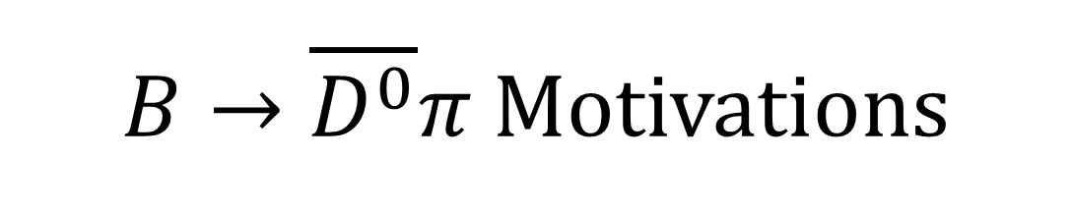
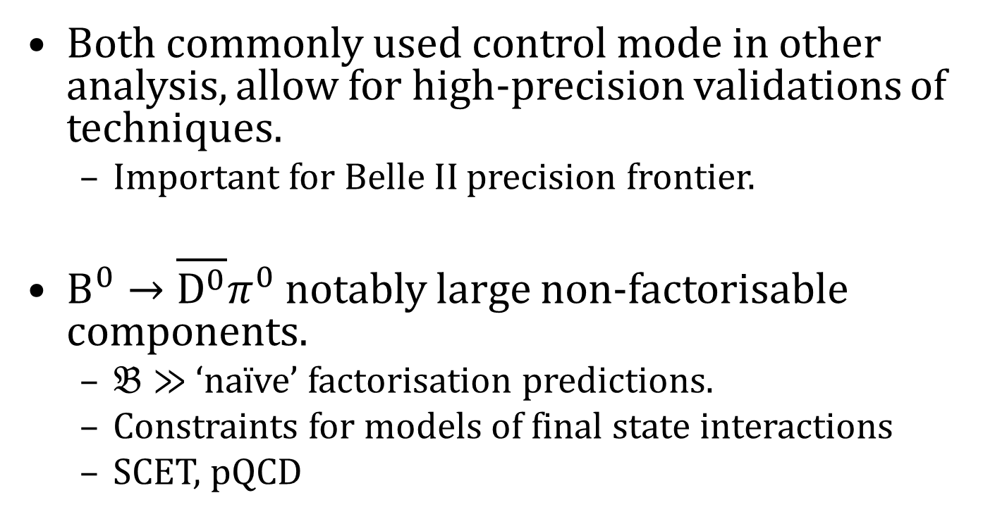
$B→\overline{D^{0}}π$ Motivations
Preliminary
Both commonly used control mode in other analysis, allow for high-precision validations of techniques.
  Important for Belle II precision frontier.
$B^{0}→\overline{D^{0}}π^{0}$ notably large non-factorisable components.
  $𝔅≫$ ‘naïve’ factorisation predictions.
  Constraints for models of final state interactions
  SCET, pQCD
Notes:
These decays are common control mode for a number of rare analysis, such as B to pi0pi0 and B to K short pi0
Used to calibrate difference between Monte Carlo and data, so accurate measurement of properties is vital
Accuracy of calibration measurements important as Belle II pushes precision frontier.
B0 to D0 bar pi0 has large non-factorizable contributions, so precise measurement of branching fraction will provide tighter experimental constraints for comparing different theory models of complex final state interactions.

Slide 9
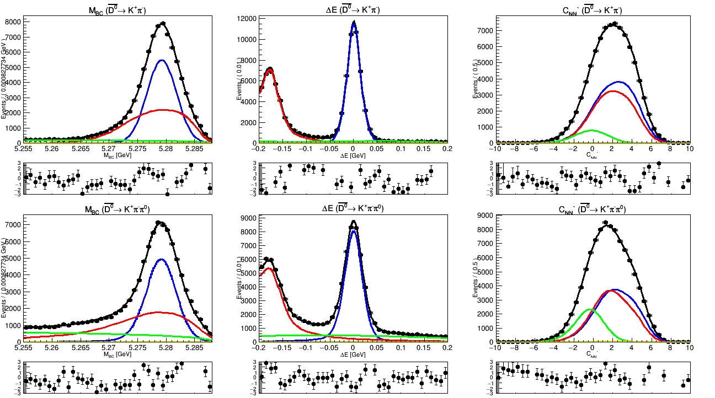
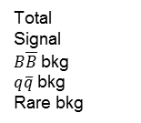
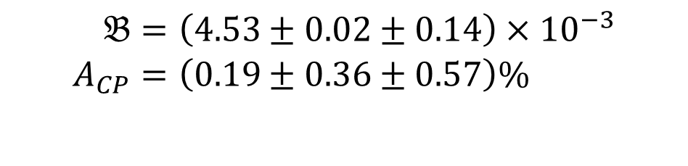
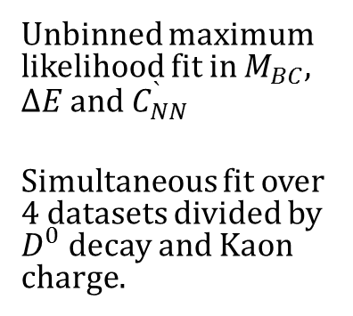
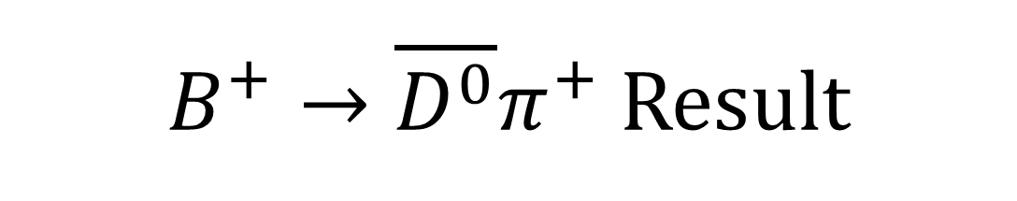
$B^{+}→\overline{D^{0}}π^{+}$ Result
Preliminary
Belle
Preliminary
Belle
Preliminary
Belle
Preliminary
Unbinned maximum likelihood fit in $M_{BC}$, $ΔE$ and $C_{NN}^{`}$
Simultaneous fit over 4 datasets divided by $D^{0}$ decay and Kaon charge.
Belle
Preliminary
Belle
Preliminary
Belle
Preliminary
Total
Signal
$B\overline{B}$ bkg
$q\overline{q}$ bkg
Rare bkg
$$\begin{aligned}𝔅&=\left(4.53±0.02±0.14\right)×{10}^{−3} \\ A_{CP}&=\left(0.19±0.36±0.57\right)\%\end{aligned}$$
~1.7x improvement in precision
Notes:
Perform 3D unbinned maximum likelihood fit simultaneously across 2 D0 decay modes.
Kaon charge used to identify the flavour of the B.
Final results uses generalised weighted mean to account for different correlated and uncorrelated systematics in the D0 decay modes.
Results are in agreement with PDG averages, with a substantial improvement in precision over previous best.

Slide 10
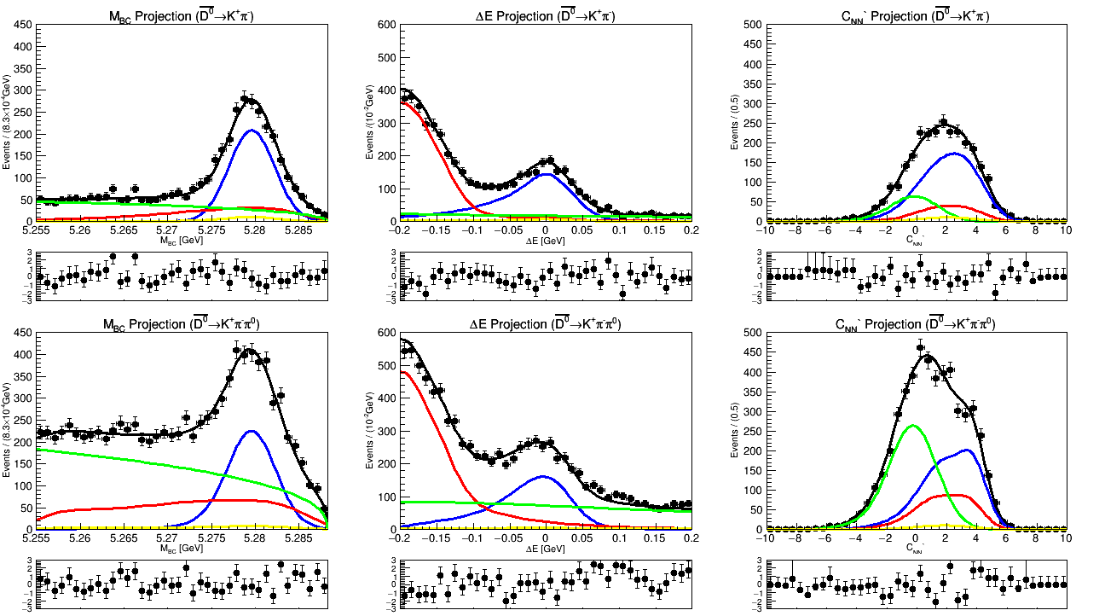
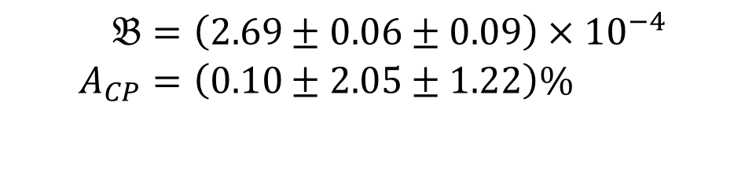
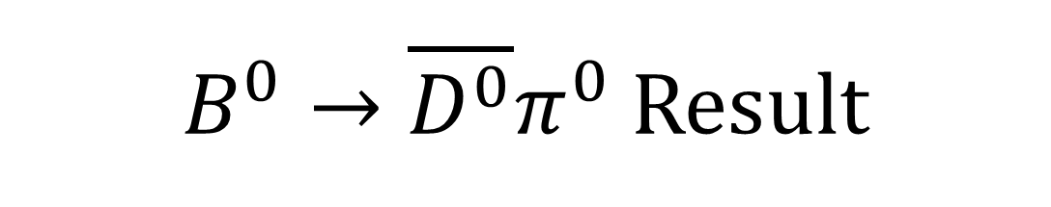
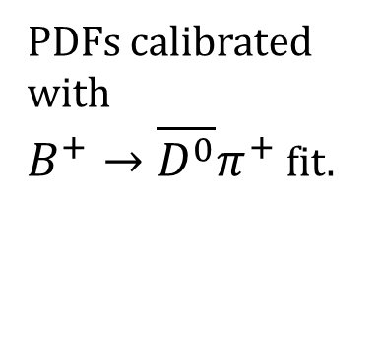
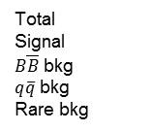
$B^{0}→\overline{D^{0}}π^{0}$ Result
Preliminary
Belle
Preliminary
Belle
Preliminary
Belle
Preliminary
PDFs calibrated with
$B^{+}→\overline{D^{0}}π^{+}$ fit.
Belle
Preliminary
Belle
Preliminary
Belle
Preliminary
Total
Signal
$B\overline{B}$ bkg
$q\overline{q}$ bkg
Rare bkg
$$\begin{aligned}𝔅&=\left(2.69±0.06±0.09\right)×{10}^{−4} \\ A_{CP}&=\left(0.10±2.05±1.22\right)\%\end{aligned}$$
Most precise measurement in this channel
First measurement in this channel
Notes:
B0 to D0 bar pi0 fit performed same way.
PDF shapes use calibration factors from the charged B measurement.
First measurement of Acp for this decay, and most precise for branching fraction

Slide 11
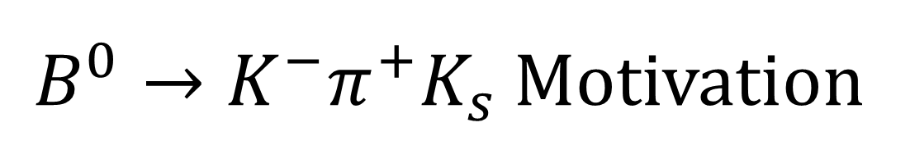
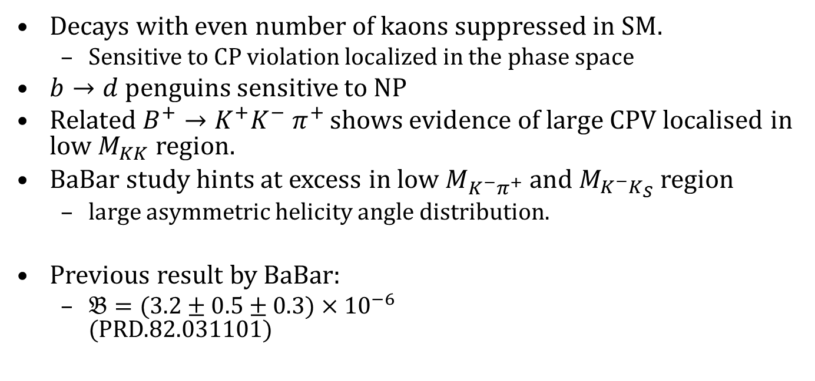
$B^{0}→K^{−}π^{+}K_{s}$ Motivation
Y.-T. Lai et al. Phys. Rev. D 100, 011101 (2019)
Decays with even number of kaons suppressed in SM.
  Sensitive to CP violation localized in the phase space
$b→d$ penguins sensitive to NP
Related $B^{+}→K^{+}K^{−} π^{+}$ shows evidence of large CPV localised in low $M_{KK}$ region.
BaBar study hints at excess in low $M_{K^{−}π^{+}}$ and $M_{K^{−}K_{S}}$region
  large asymmetric helicity angle distribution.
Previous result by BaBar:
  $𝔅=(3.2±0.5±0.3)×{10}^{−6}$
  (PRD.82.031101)
Notes:
Charmless decays sensitive to localised CP violation
Similar decay $B^{+}→K^{+}K^{−} π^{+}$ shows evidence of large CPV in low $M_{KK}$ region
Decay mainly proceeds via $b→d$ penguins provides an opportunity to search for physics beyond the SM since new heavy particles may cause deviations from SM predictions.
Study by BaBar indicates some hints of excess in the low $M_{K^{−}π^{+}}$ and $M_{K^{−}K_{S}}$region with highly asymmetric helicity angle distribution.

Slide 12
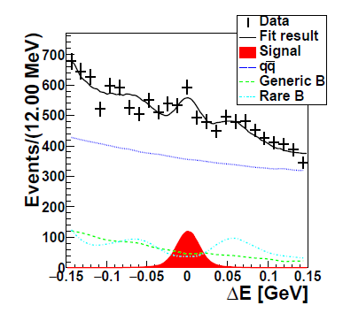
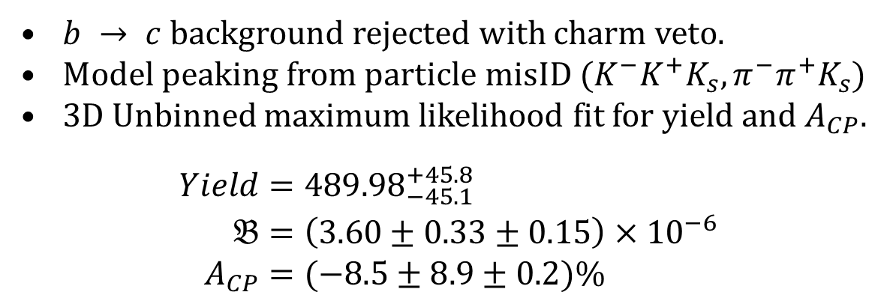
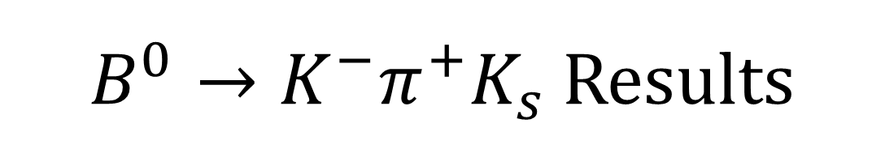
$B^{0}→K^{−}π^{+}K_{s}$ Results
Y.-T. Lai et al. Phys. Rev. D 100, 011101 (2019)
$b → c$background rejected with charm veto.
Model peaking from particle misID ($K^{−}K^{+}K_{s}, π^{−}π^{+}K_{s}$)
3D Unbinned maximum likelihood fit for yield and $A_{CP}$.
$$\begin{aligned}Yield=&{489.98}_{−45.1}^{+45.8} \\ 𝔅=&\left(3.60±0.33±0.15\right)×{10}^{−6} \\ A_{CP}=&(−8.5±8.9±0.2)\%\end{aligned}$$
Notes:
Charmed background removed with veto around D mass.
Peaking in delta E from mis Ided charged particles is modelled.
3D unbinned maximum likelihood fit.
Branching fraction consistent with PDG, with improved precision
Acp consistant with 0.

Slide 13
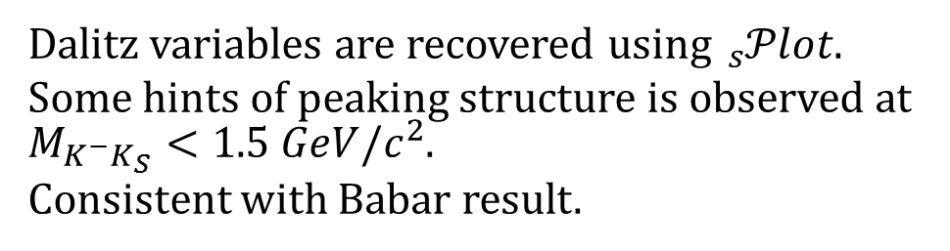
$B^{0}→K^{−}π^{+}K_{s}$ Results
Y.-T. Lai et al. Phys. Rev. D 100, 011101 (2019)
Dalitz variables are recovered using${}_{s}^{}{𝒫lot}$.
Some hints of peaking structure is observed at $M_{K^{−}K_{S}}<1.5 GeV/c^{2}$.
Consistent with Babar result.
Notes:
Dalitz plot study performed using sPlot
Consistant with the Babar result there are indications of peaking structure in the low $M_{K^{−}K_{S}}$ region.
Shown in middle plot compared to phase space Monte Carlo.

Slide 14
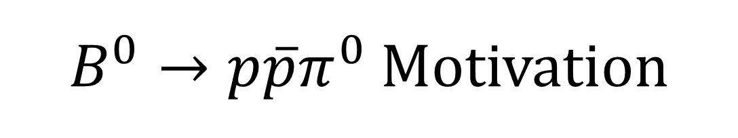
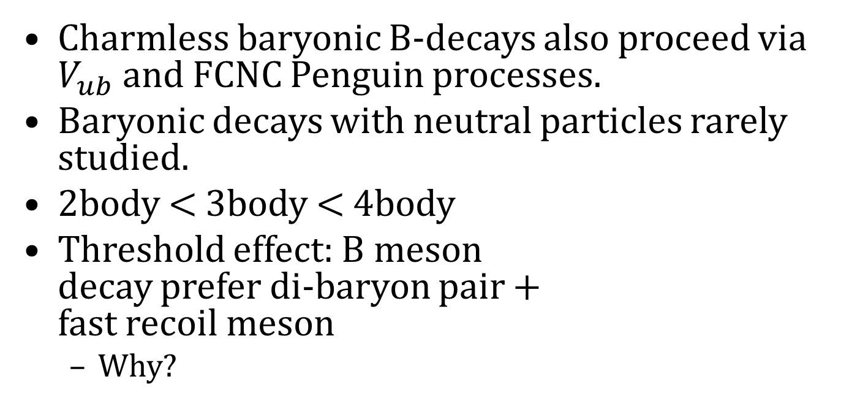
$B^{0}→p\overline{p}π^{0}$ Motivation
B. Pal et al. Phys. Rev. D 99, 091104 (2019)
Charmless baryonic B-decays also proceed via $V_{ub}$ and FCNC Penguin processes.
Baryonic decays with neutral particles rarely studied.
2body < 3body < 4body
Threshold effect: B meson
decay prefer di-baryon pair +
fast recoil meson
  Why?
Notes:
Baryonic decays are similarly sensitive to CP violation.
Few studies on baryonic B decays with neutral final state particles.
Three-body decays are usually more frequent than their two-body counterparts, but less frequent than four-body decays. This phenomenon can be understood in terms of the so-called “threshold effect”, which indicates that the B meson prefers to decay into di-baryon pair with low invariant mass accompanied by a fast recoil meson.

Slide 15
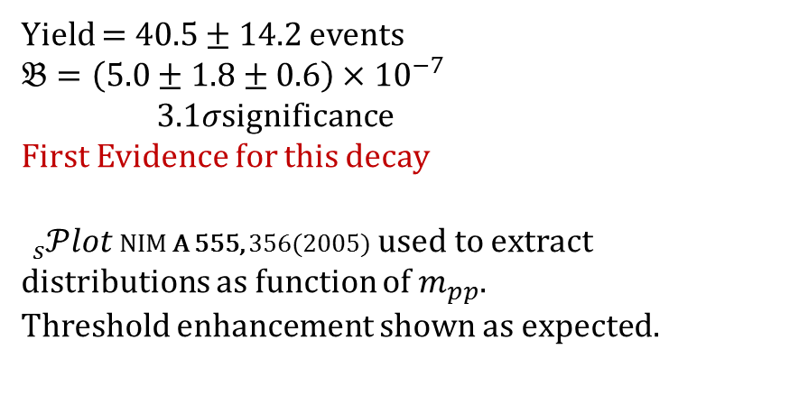
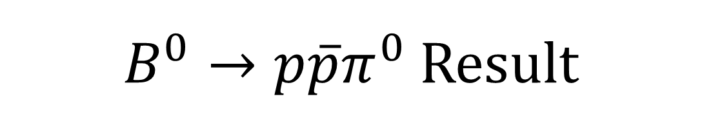
$B^{0}→p\overline{p}π^{0}$ Result
B. Pal et al. Phys. Rev. D 99, 091104 (2019)
Yield = $40.5±14.2$ events
$𝔅=\left(5.0±1.8±0.6\right)×{10}^{−7}$
$3.1σ$significance
First Evidence for this decay
${}_{s}^{}{𝒫lot}$ NIM A 555, 356(2005) used to extract distributions as function of $m_{pp}$.
Threshold enhancement shown as expected.
Notes:
3D maximum unbinned likelihood fit performed.
Branching fraction measured with over 3$σ$ significance,
This is the first evidence for this decay occurring.
sPlot is used to remove backgrounds and study distribution in p p-bar invariant mass.
As expected, enhancement is shown in the low M_pp region.

Slide 16
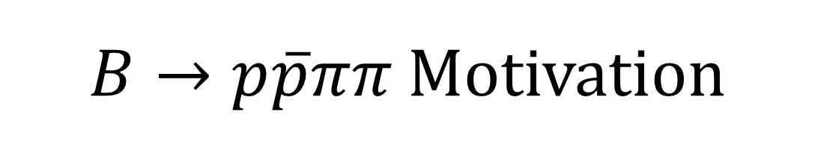
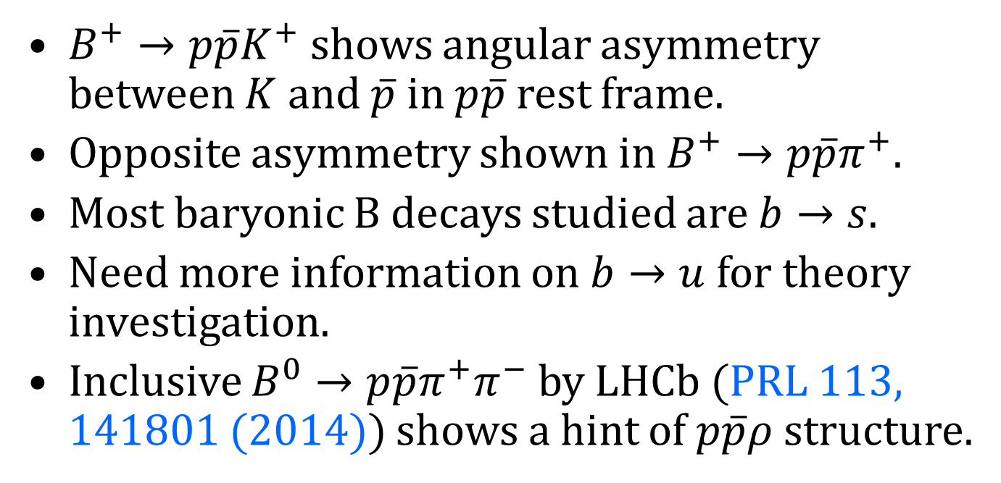
$B→p\overline{p}ππ$ Motivation
Preliminary
$B^{+}→p\overline{p}K^{+}$ shows angular asymmetry between $K$ and $\overline{p}$ in $p\overline{p}$ rest frame.
Opposite asymmetry shown in $B^{+}→p\overline{p}π^{+}$.
Most baryonic B decays studied are $b→s$.
Need more information on $b→u$ for theory investigation.
Inclusive $B^{0}→p\overline{p}π^{+}π^{−}$ by LHCb (PRL 113, 141801 (2014)) shows a hint of $p\overline{p}ρ$ structure.
Notes:
Studies of $B^{+}→p\overline{p}K^{+}$ and $B^{+}→p\overline{p}π^{+}$ show large angular asymmetry for the meson in the p pbar rest frame. This is of opposite signs for kaons and pions.
Baryonic b->s decays are the most frequently studied, so investigations of b->u decays needed to shed light on this phenomenon.
Study by LHCb has shown indications of rho resonance structures in $B^{0}→p\overline{p}π^{+}π^{−}$.

Slide 17

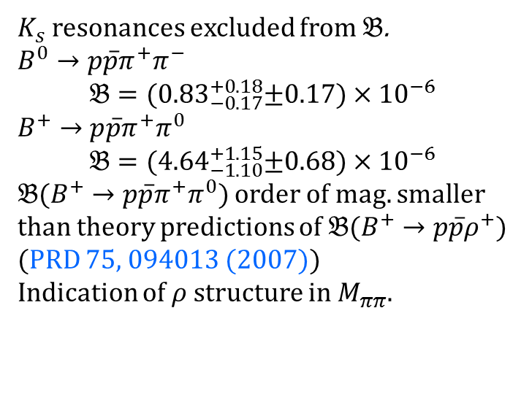


$B→p\overline{p}ππ$ Result
Preliminary
Belle
Preliminary
$B^{0}→p\overline{p}π^{+}π^{−}$
$B^{+}→p\overline{p}π^{+}π^{0}$
Belle
Preliminary
Belle
Preliminary
$K_{s}$ resonances excluded from $𝔅$.
$B^{0}→p\overline{p}π^{+}π^{−}$
$$𝔅={(0.83}_{−0.17}^{+0.18}±0.17)×{10}^{−6}$$
$B^{+}→p\overline{p}π^{+}π^{0}$
$$𝔅={(4.64}_{−1.10}^{+1.15}±0.68)×{10}^{−6}$$
$𝔅(B^{+}→p\overline{p}π^{+}π^{0})$ order of mag. smaller than theory predictions of $𝔅(B^{+}→p\overline{p}ρ^{+})$ (PRD 75, 094013 (2007))
Indication of $ρ$ structure in $M_{ππ}$.
Belle
Preliminary
Belle
Preliminary
Notes:
2D fit in Mbc and deltaE.
Branching fraction for neutral B shown here is after removing Kshort to pipi resonances.
Charged B branching fraction is an order of magnitude lower than expected from theory predictions.
Not enough events to study angular distribution.
There are some hints of rho structure in the Mpipi distribution.

Slide 18
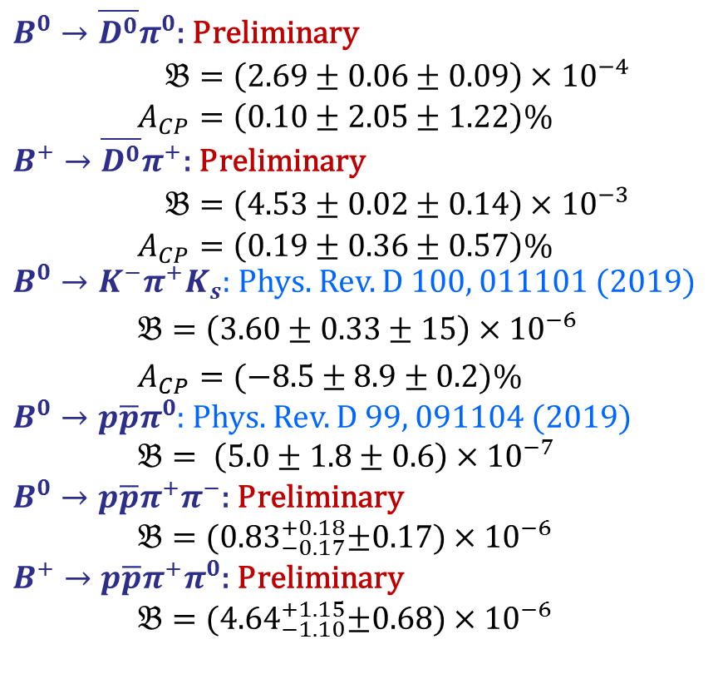
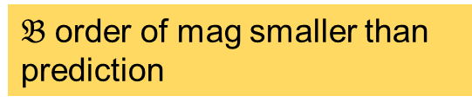
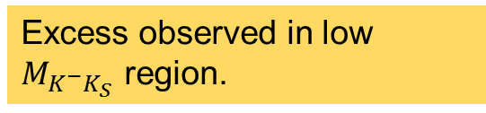
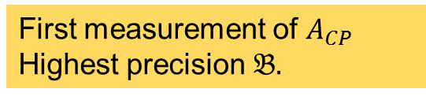
Conclusion
$B^{0}→\overline{D^{0}}π^{0}$: Preliminary
$\begin{aligned}𝔅&=\left(2.69±0.06±0.09\right)×{10}^{−4} \\ A_{CP}&=\left(0.10±2.05±1.22\right)\%\end{aligned}$
$B^{+}→\overline{D^{0}}π^{+}$: Preliminary
$\begin{aligned}𝔅&=\left(4.53±0.02±0.14\right)×{10}^{−3} \\ A_{CP}&=\left(0.19±0.36±0.57\right)\%\end{aligned}$
$B^{0}→K^{−}π^{+}K_{s}$: Phys. Rev. D 100, 011101 (2019)
$𝔅=\left(3.60±0.33±15\right)×{10}^{−6}$
$A_{CP}=(−8.5±8.9±0.2)\%$
$B^{0}→p\overline{p}π^{0}$: Phys. Rev. D 99, 091104 (2019)
$𝔅= \left(5.0±1.8±0.6\right)×{10}^{−7}$
$B^{0}→p\overline{p}π^{+}π^{−}$: Preliminary
$𝔅={(0.83}_{−0.17}^{+0.18}±0.17)×{10}^{−6}$
$B^{+}→p\overline{p}π^{+}π^{0}$: Preliminary
$𝔅={(4.64}_{−1.10}^{+1.15}±0.68)×{10}^{−6}$
First measurement of $A_{CP}$
Highest precision $𝔅.$
Most precise measurement by almost 2x.
Excess observed in low $M_{K^{−}K_{S}}$ region.
First Observation of this decay
$𝔅$ order of mag smaller than prediction
Notes:
In conclusion, results have been presented on:
The first measurement of Acp for B0 to D0bar pi0 as well as most precise branching fraction.
The highest precision measurement of B+ to B0bar pi+ branching fration and Acp.
Study of B0 to K pi K short observes an excess in low M k k short region in agreement with Babar.
First observation of B0 to p p bar pi0.
Measurement of branching fraction for B to p p bar pi pi found to be order of magnitude lower than predictions for b to p p bar rho.

Slide 19

Thank You

Slide 20
Backup

Slide 21
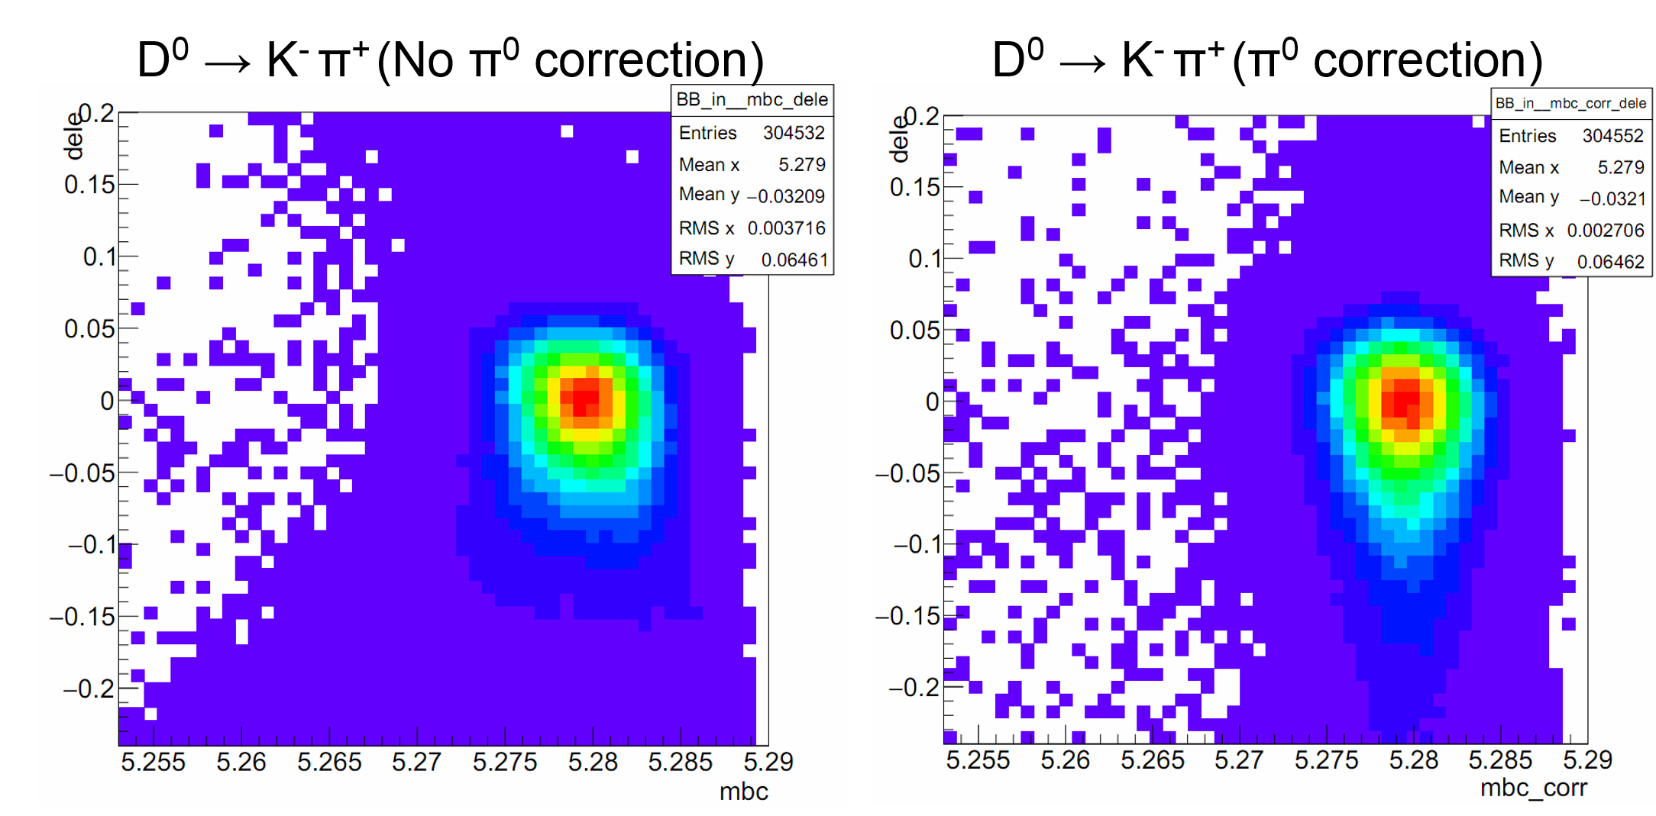
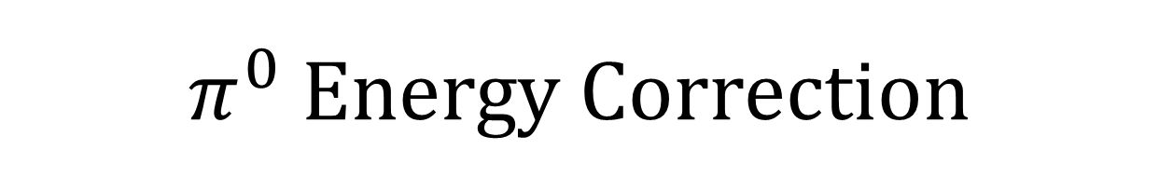
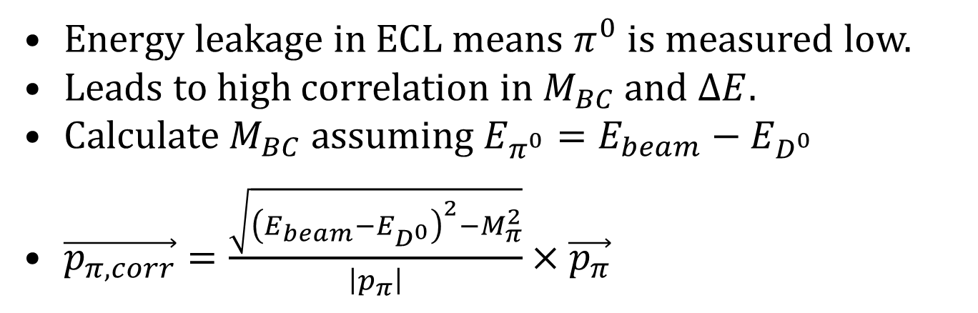
$π^{0}$ Energy Correction
Energy leakage in ECL means $π^{0}$ is measured low.
Leads to high correlation in $M_{BC}$ and $ΔE$.
Calculate $M_{BC}$ assuming $E_{π^{0}}=E_{beam}−E_{D^{0}}$
$\vec{p_{π,corr}}=\frac{\sqrt{{\left(E_{beam}−E_{D^{0}}\right)}^{2}−M_{π}^{2}}}{\left|p_{π}\right|}×\vec{p_{π}}$
Notes:
One problem with having pi0s in the final state is the ELC is not perfect.
Energy leakage will result in the underestimation of gamma energy, and thus pi0 momentum.
This results in the MBC and delta E parameters being correlated to an annoying degree.
See left diagram, in the tails of the delta E distribution the MBC shape flattens out and number of low MBC events increases.
To try and fix they we calculate MBC under the assumption that the Delta E = 0 and any energy loss it put into the pi0.
We use this to rescale the pi0 momentum as shown, and then use this corrected value to recalculate MBC
Shown on the left, new MBC and delta E are much less correlated.
In the case of the D0bar -> K+pi-pi0 we can’t do anything with the 2nd pi0, which will be a bit of a problem latter when we fit PDFs to these.

Slide 22
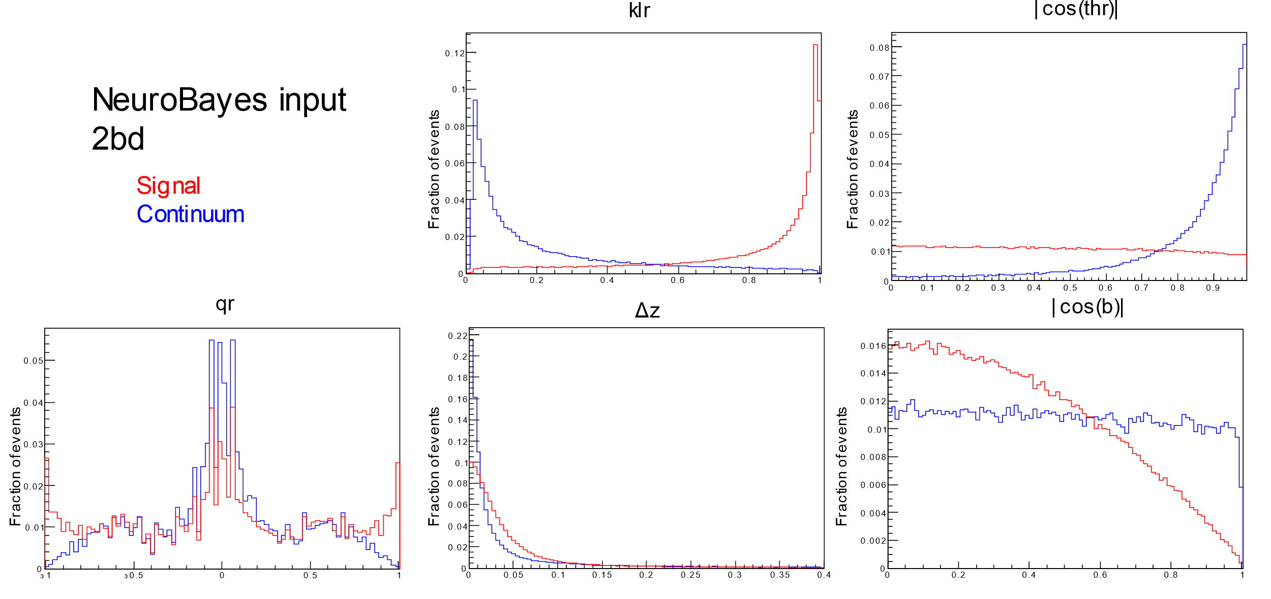
Continuum Suppression Variables
Notes:
5 components in the neural network, distribution shown here with signal in right and continuum in left.

Slide 23
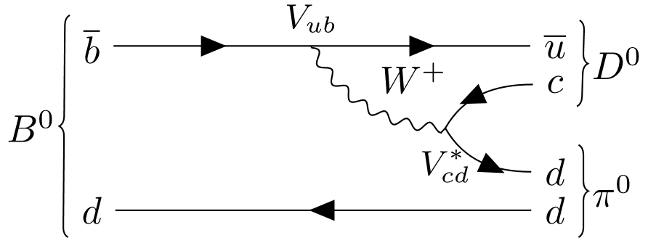

Wrong sign decays.
What if $B^{0}→D^{0}π^{0}$ or $\overline{D^{0}}→K^{−}π^{+}[π^{0}]$?
$B^{0}→D^{0}π^{0}$ suppressed by $λ^{2}$.
$$R≡\frac{𝔅_{WS}}{𝔅_{RS}}$$
$R\left(B^{0}→D^{0}π^{0}\right)≈$ $R\left(B^{0}→D^{−}π^{+}\right)=2.92×{10}^{−4}$
$R\left(\overline{D^{0}}\right)=\text{2}\text{.}\text{8}\text{5}×{10}^{−3}$
$$Δ𝔅=−0.3\% ΔA_{CP}=+3×{10}^{−5}$$
Notes:
Said use kaon charge to determine the flavour of B, but this is not 100%.
Wrong sign decays as shown here exist. Called doubly Cabibbo suppressed as their much smaller CKM terms lower their amplitude by a factor of lambda^2 over Cabibbo favoured modes.
To see the effect of these wrong sign decays we define R as the ratio of wrong sign to right sign decays.
For the D0 decays this is measured to be ~3x10^-3 average over both modes.
For $B^{0}→D^{0}π^{0}$ R hasn’t been measured, but expect to be same as $B^{0}→D^{−}π^{+}$ which is ~3x10^-4
Real compared to measured $Δ𝔅=−0.3\% ΔA_{CP}=+3×{10}^{−5}$
For branching fraction small but will correct for, Acp is << uncertainty so is neglected.

Slide 24

Fitter
Unbinned maximum likelihood fit in $M_{BC}$, $ΔE$ and $C_{NN}^{`}$ using RooFit for Yield and $A_{CP}$ of each event type (signal, qq, $B\overline{B}$ bkg, Rare).
4 datasets divided by $D^{0}$ decay and Kaon charge.
Constrained by $\overline{D^{0}}→K^{+}π^{−}π^{0}$: $\overline{D^{0}}→K^{+}π^{−}$ Yield ratio and $A_{CP}$.
  $N_{K^{+},2bd}=N×\left(1−A_{CP}\right)×0.5×(1−R_{D^{0}mode})$
  $N_{K^{−},2bd}=N×\left(1+A_{CP}\right)×0.5×(1−R_{D^{0}mode})$
  $N_{K^{+},3bd}=N×\left(1−A_{CP}\right)×0.5×(R_{D^{0}mode})$
  $N_{K^{−},3bd}=N×\left(1+A_{CP}\right)×0.5×(R_{D^{0}mode})$
Background $A_{CP}$ and signal $R_{D^{0}mode}$ are fixed.
PDF shapes from Monte Carlo.
Notes:
For our fitter we use Roofit as part of the root framework, and perform a simultaneous maximum likelihood fit in MBC delta E and Cnn`
Performed simultaneously over 4 datasets binned by D0 decay mode and kaon charge.
Yield in each bin is related to Total yield by Acp and the D0 decay mode ratio.
This exists for each type of event (signal, qq, $B\overline{B}$ bkg, Rare)
For backgrounds Acp is fixed and the ratio between the different D0 decay bins is free to float.
While for signal this is held constant based on MC studies, and the Acp is floated.

Slide 25


PDF Modelling
Where possible
  $𝒫\left(M_{BC},ΔE,C_{NN}^{`}\right)=𝒫\left(M_{BC}\right)×𝒫\left(ΔE\right)×𝒫\left(C_{NN}^{`}\right)$
$B\overline{B}$ and Rare background and $K^{+}π^{−}π^{0}$ signal have high correlation in $M_{BC},ΔE$.
  $𝒫\left(M_{BC},ΔE,C_{NN}^{`}\right)=𝒫\left(M_{BC},ΔE\right)×𝒫\left(C_{NN}^{`}\right)$
 | $$M_{BC}$$ | $$ΔE$$ | $$C_{NN}`$$
Signal ($\overline{D^{0}}→K^{+}π^{−})$ | Crystal Ball fn. | Crystal Ball fn. + Gaussian | 3 Gaussians
Signal ($\overline{D^{0}}→K^{+}π^{−}π^{0})$ | 2D kernel estimation (KEST) histogram PDF |  | 3 Gaussians
$B\overline{B}$ background | 2D kernel estimation (KEST) histogram PDF |  | 3 Gaussians
Continuum | ARGUS fn. | Chebyshev Polynomial | 2 Gaussians
Rare B | 2D kernel estimation (KEST) histogram PDF |  | 3 Gaussians
Notes:
We try to model as product of 3 1D PDFs where possible for ease.
However due to high correation between MBC and delta E in a number of components, some 2D PDFs are needed.
Cnn` is uncorrelated.
List types.

Slide 26

KEST PDF for 2D MC based models
Kernel density estimation models dataset by superposition of kernel function (Gaussian) for each datapoint.
Roofit uses adaptive bandwidth to adjust Gaussian width based on local event density.
Retains information in high density areas while smoothing low density.
Notes:
For those that need 2D modelling due to correlations we use kernel density estimation.
Similar to histograms, where instead of binning data, each point is represented by a kernel function that superimpose to form a PDF.
Diagram on left shows how this compares to a histogram.
Typically this kernel is a Gaussian, where width is known as the bandwidth, by varying this the degree to which detail is retained or smoothed.
Right shows the same distribution fitted with kernels of different bandwidth.
Roofit uses an algorithm to dynamically vary the bandwidth based on the local event density.
This means when event density is high and thus uncertainty low we retain information, while low density areas with high uncertainty are smoothed to reduce statistical noise.

Slide 27



Calibration Factors
MC may not perfectly represent real data.
Calibration mean shifts and width factors for $C_{NN}^{`}$.
  Applied to $B→\overline{D^{0}}π^{0}$ for data fit.
Signal $ΔE$ has shaped changes.
  $\overline{D^{0}}→K^{+}π^{−}$: Mean shift and width factor floated in fit.
  $\overline{D^{0}}→K^{+}π^{−}π^{0}$: New PDF Gaussian smear to $ΔE$.
Notes:
Mentioned surprises from real data. These come in the form of discrepancies between simulated MC and data.
We add calibration factors to PDFs where possible, in the form of small mean shifts and width factors.
These are added to all the Cnn` PDFs, as well as the analytic $\overline{D^{0}}→K^{+}π^{−}$ signal PDF.
For Cnn` these are floated in the control mode fit, and these values then fixed and applied to PDF when we later fit to the signal channel.
For MBC and delta E in the signal PDF these are left floating in both fits to reduce the systematics from fixed shapes.
For $\overline{D^{0}}→K^{+}π^{−}π^{0}$ however, we can’t use calibration factors with parameterless kernel density PDFs.
But some correction is needed, see plot.
We fit new kernel density PDFs to a new variable that is Delta E + random number from a Gaussian distribution.
This smears out the distribution acting as a width factor. See PDF after.

Slide 28

GWM Calculations
$\begin{aligned}𝔅&=mean\left(𝔅_{\overline{D^{0}}→K^{+}π^{−}},𝔅_{\overline{D^{0}}→K^{+}π^{−}π^{0}}\right) \\ &=mean\left(\frac{Y_{\overline{D^{0}}→K^{+}π^{−}}}{2×N_{B^{+}B^{−}}×ε_{\overline{D^{0}}→K^{+}π^{−}}},\frac{Y_{\overline{D^{0}}→K^{+}π^{−}π^{0}}}{2{×N}_{B^{+}B^{−}}×ε_{\overline{D^{0}}→K^{+}π^{−}π^{0}}}\right) \\ &=mean\left(\frac{f_{\overline{D^{0}}→K^{+}π^{−}}^{s}×Y}{2×N_{B^{+}B^{−}}×ε_{\overline{D^{0}}→K^{+}π^{−}}},\frac{f_{\overline{D^{0}}→K^{+}π^{−}π^{0}}^{s}×Y}{2×N_{B^{+}B^{−}}×ε_{\overline{D^{0}}→K^{+}π^{−}π^{0}}}\right) \\ &=\frac{Y}{2×N_{B^{+}B^{−}}}×mean\left(\frac{f_{\overline{D^{0}}→K^{+}π^{−}}^{s}}{ε_{\overline{D^{0}}→K^{+}π^{−}}},\frac{f_{\overline{D^{0}}→K^{+}π^{−}π^{0}}^{s}}{ε_{\overline{D^{0}}→K^{+}π^{−}π^{0}}}\right),\end{aligned}$
$\overline{x}=σ_{\overline{x}}^{2}\left(J^{T}Σ^{−1}X\right)$
$σ_{\overline{x}}^{2}={\left(J^{T}Σ^{−1}J\right)}^{−1}$
Uncorrelated: $D$ decay $𝔅$, recon eff.
Correlated: Track eff., $π^{0}$ eff., PID eff.
$\begin{aligned}Σ_{B^{0}\overline{D^{0}}π^{0}}=\left[\begin{matrix}1.48 & 2.40 \\ 2.40 & 6.77\end{matrix}\right], Σ_{B^{+}\overline{D^{0}}π^{+}}=\left[\begin{matrix}1.17 & 1.05 \\ 1.05 & 4.03\end{matrix}\right]\end{aligned}$
$2.44\%$ for $B^{0}→\overline{D^{0}}π^{0}$ and $2.54\%$ for $B^{+}→\overline{D^{0}}π^{+}$

Slide 29

Systematic Uncertainties $(𝔅)$
Notes:
Contributors to systematic uncertainty in branching fraction.
Biggest pi0 efficiency correction and D0 subdecay branching fraction uncert.

Slide 30

Systematic Uncertainties ($A_{CP}$)
Notes:
Biggest from Detector bias and D0 subdecay Acp.
Two detector bias uncertainties are correlated

