Slide 1
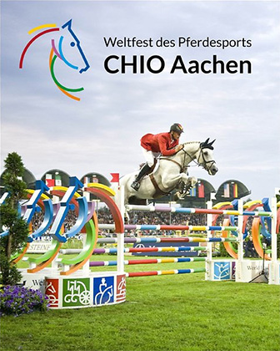
PIC 2020: Aachen
Particlephysics in Aachen
Historical City – Roman Origin – German Capital 800 A.D.: Charles the Great
Equestrian Sport: CHIO
Technical University

Slide 2
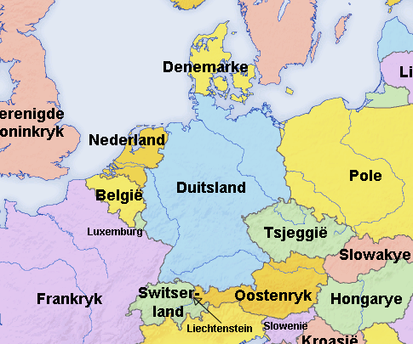
The City of Aachen
In the Euregio: Belgium-Netherlands-Germany
240.000 people living in Aachen
Historical city center (pedestrian area)
International Airports
Frankfurt (1h40 / 2h30 by train)
Brussels (2h by train)
Düsseldorf (1h40 by train)
Cologne (1h30 by train)
Aachen/Maastricht (30 min by bus)

Slide 3
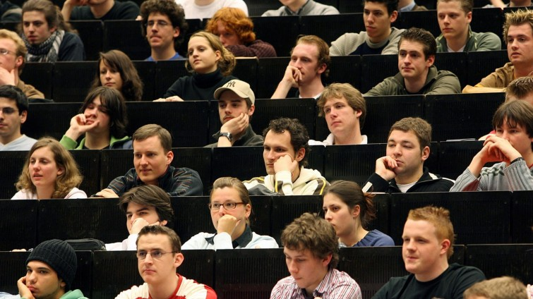
Largest Technical University in Germany
German Ivy League
45.000 Students (8.000 international)
Focus Engineering & Nat. Science
250 new students in Physics each year

Slide 4
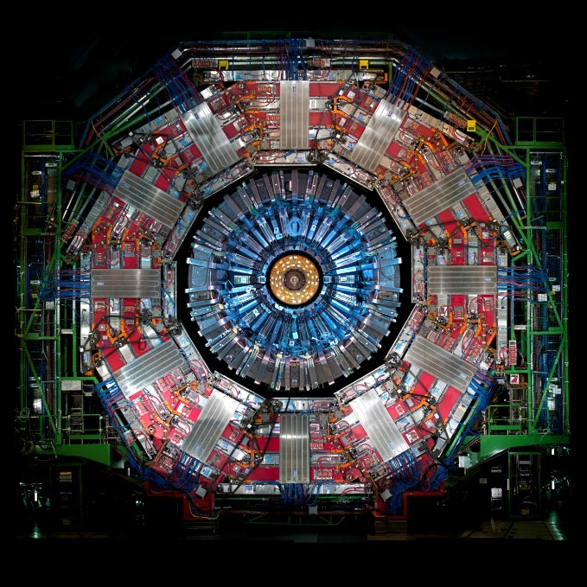
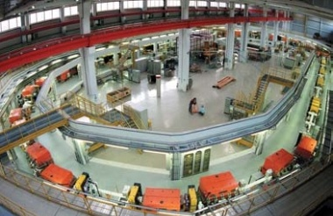
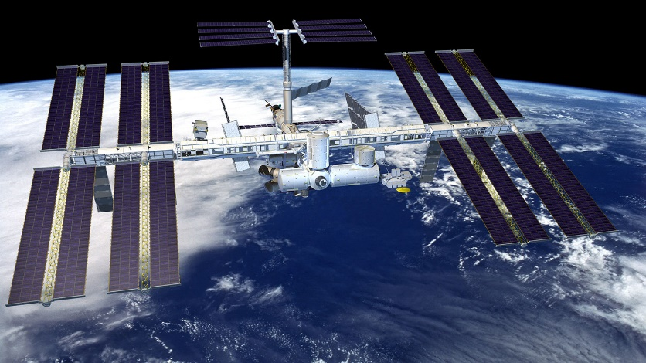
Particle physics in Aachen
Approx. 200 Scientists / 5 chairs
Stefan Schael: AMS, LHCb
Thomas Hebbeker: CMS, Auger, MadMax
Achim Stahl: CMS, Neutrinos, proton-EDM
Michael Krämer: Theory
Julien Lesgourgues: Cosmology

Slide 5
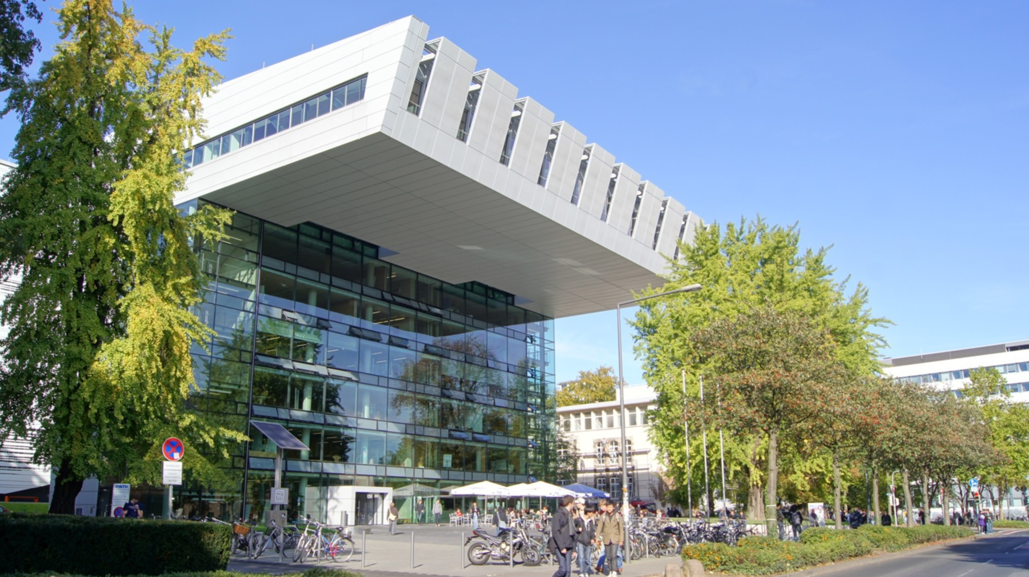
Venue
2 Conference Rooms
Max. 120 people each
Large foyer
Coffee shop (ground floor)
Int. Workshop on Tau Lepton Physics, 2014: Conference fee was 290,-€ + 60,-€ (dinner)
http://tau2014.physik.rwth-aachen.de

Slide 6
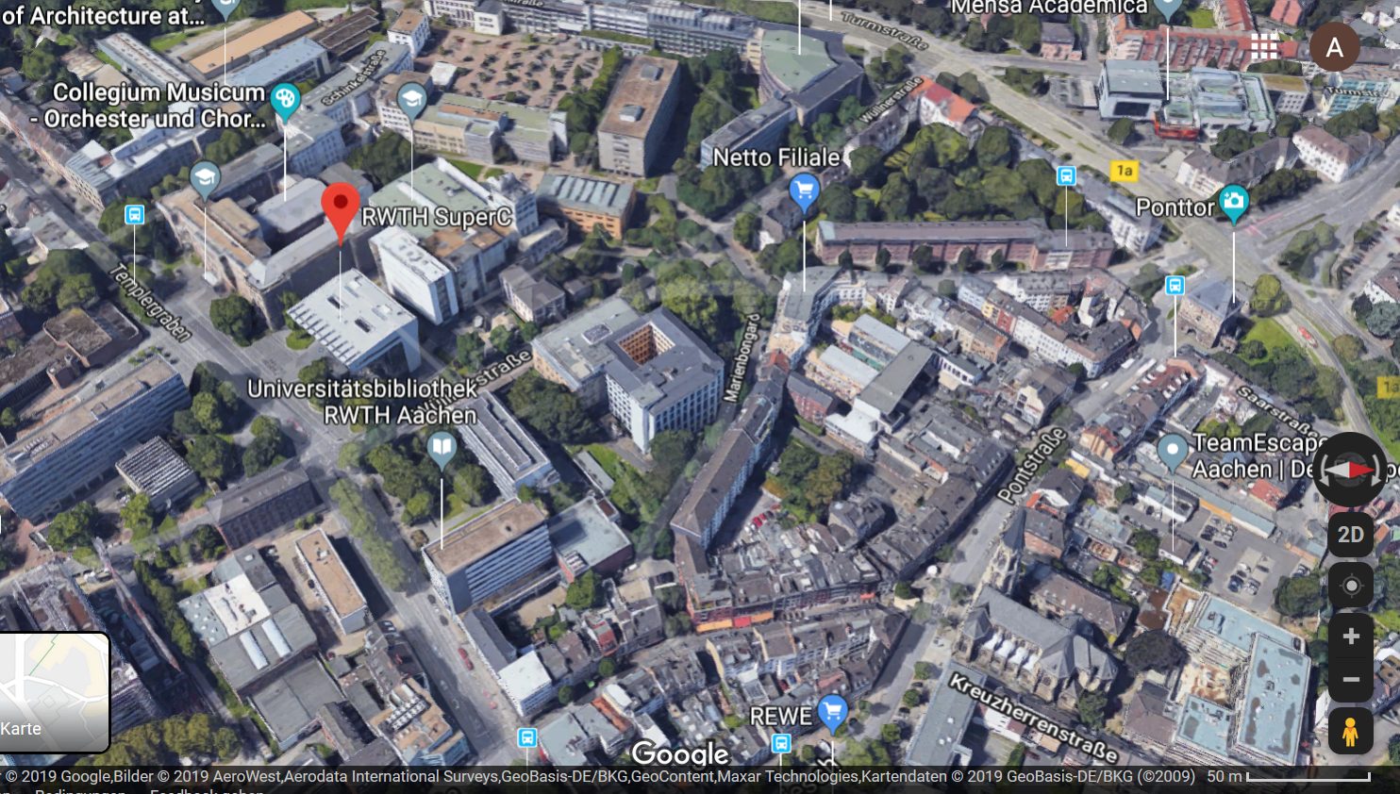
Google‘s view of the venue

Slide 7
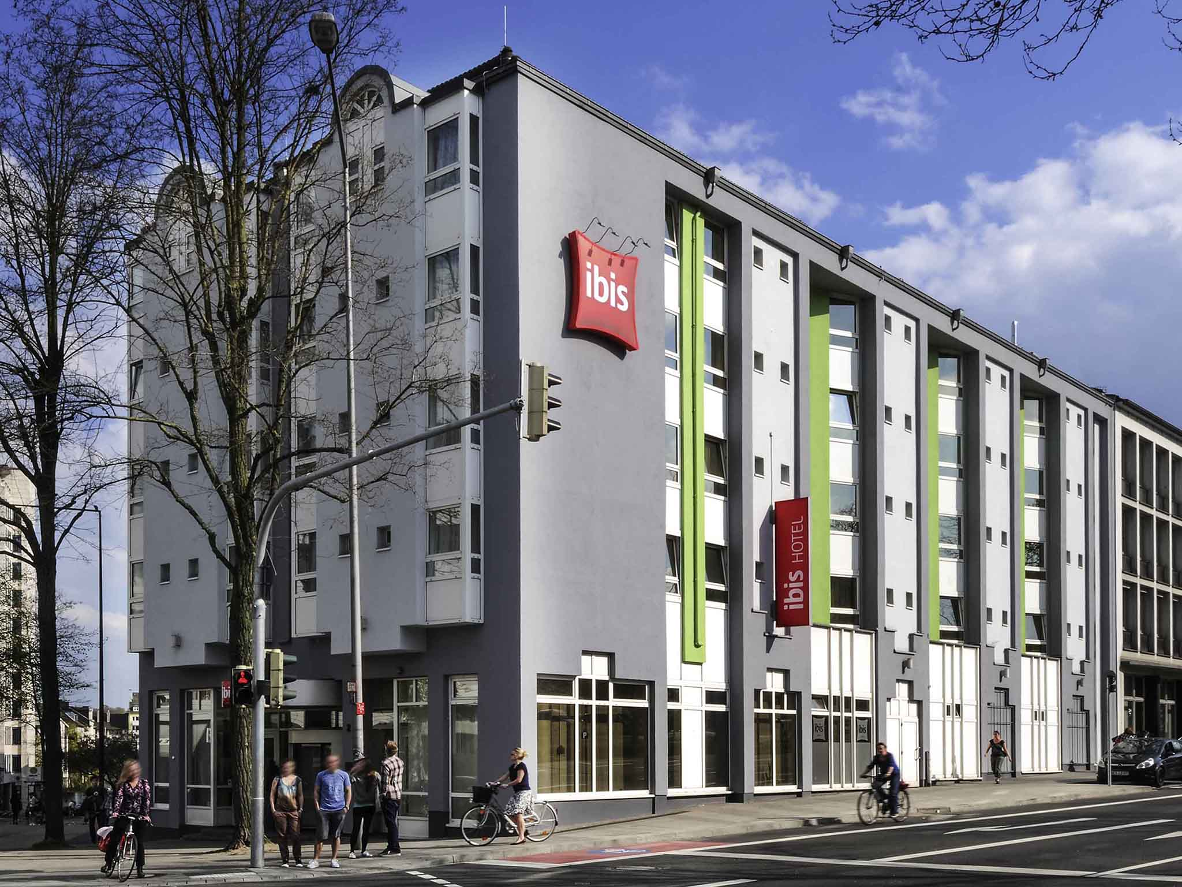
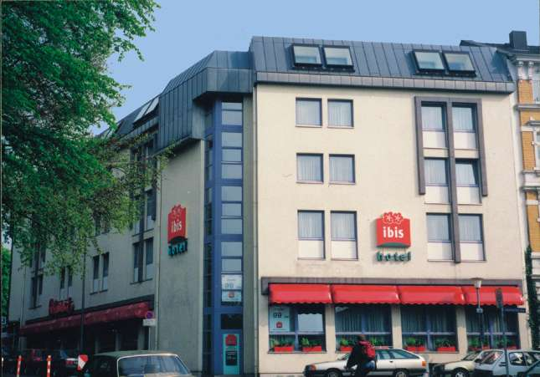
Hotels in Aachen
Hotel ibis Hauptbahnhof
Hotel ibis Marschiertor
128 rooms
104 rooms
around 80€ per night + breakfast

Slide 8
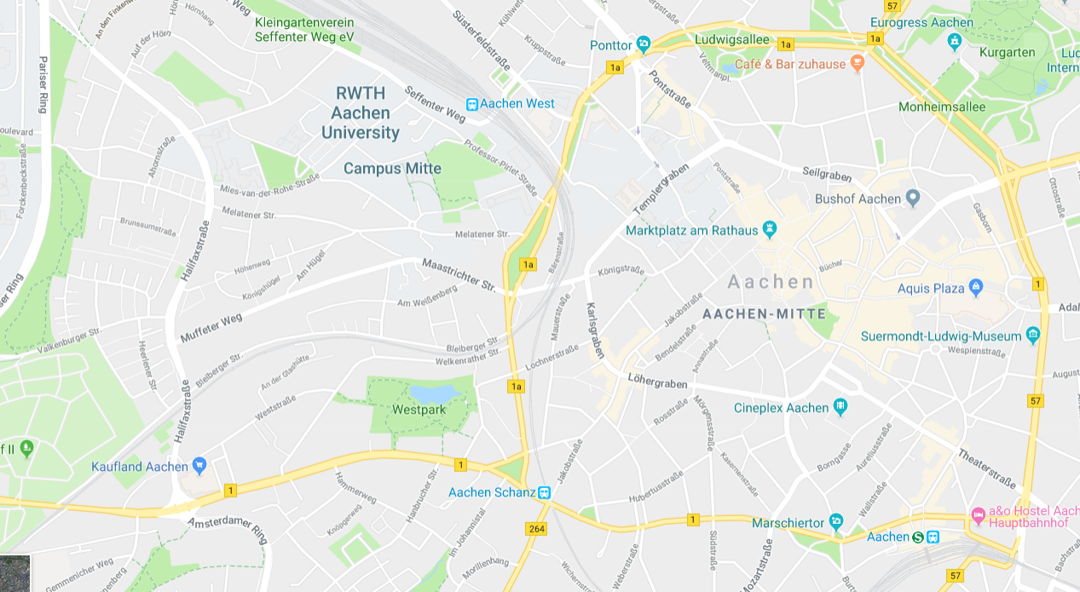
Locations
lunch
conference
Market square
200 m
Hotel
Hotel
Train station

Slide 9
Travel to Aachen
London
4:00 by train
Airport
Düsseldorf
1:40 by train
Airport
Aachen/Maastricht
0:30 by bus
Aachen
Paris
2:40 by train
Airport
Cologne
1:40 by train
Airport
Brussels
2:00 by train
Airport
Frankfurt
1:40/2:00

Slide 10
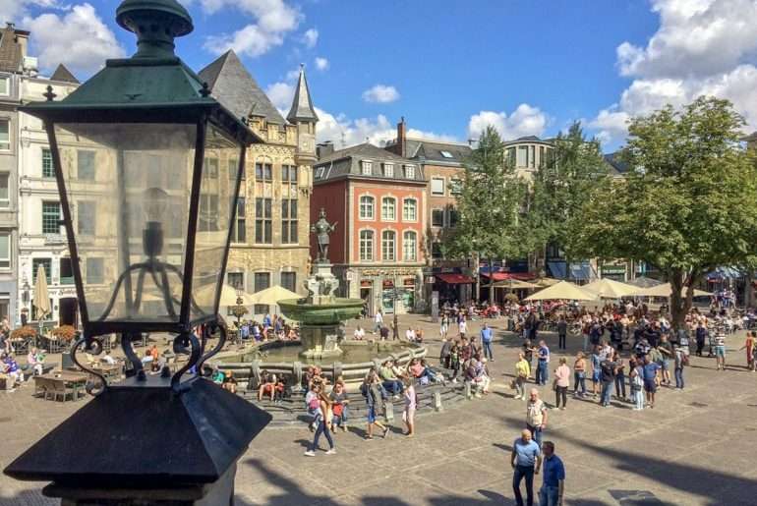
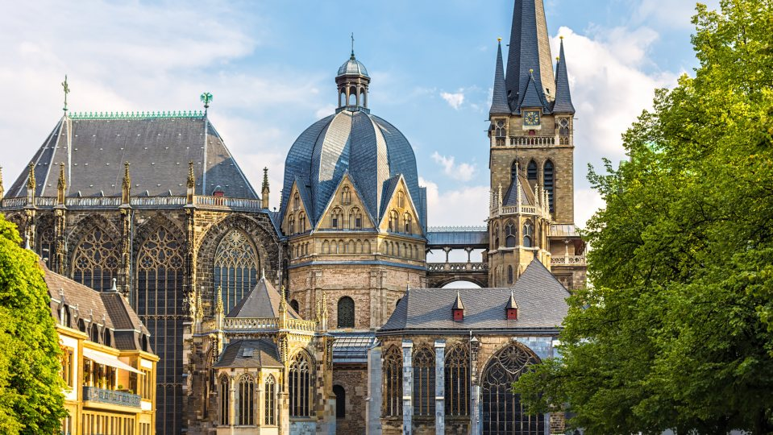
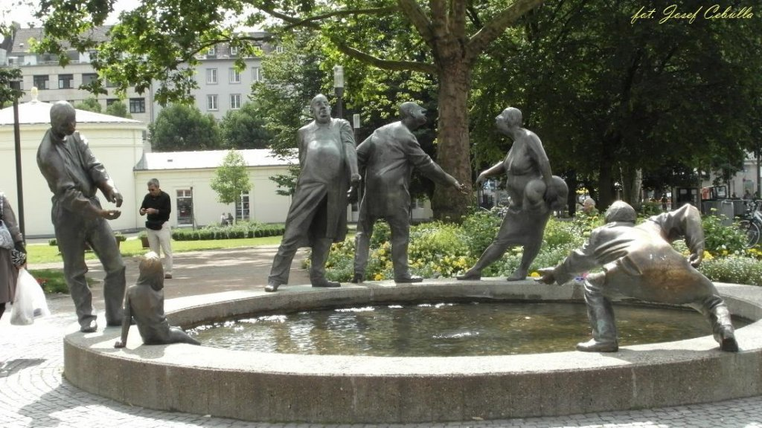
Excursion
We propose
2 shorter (local) visits
Cathedral (founded in 800 A.C.)
Guided City Walk

Slide 11
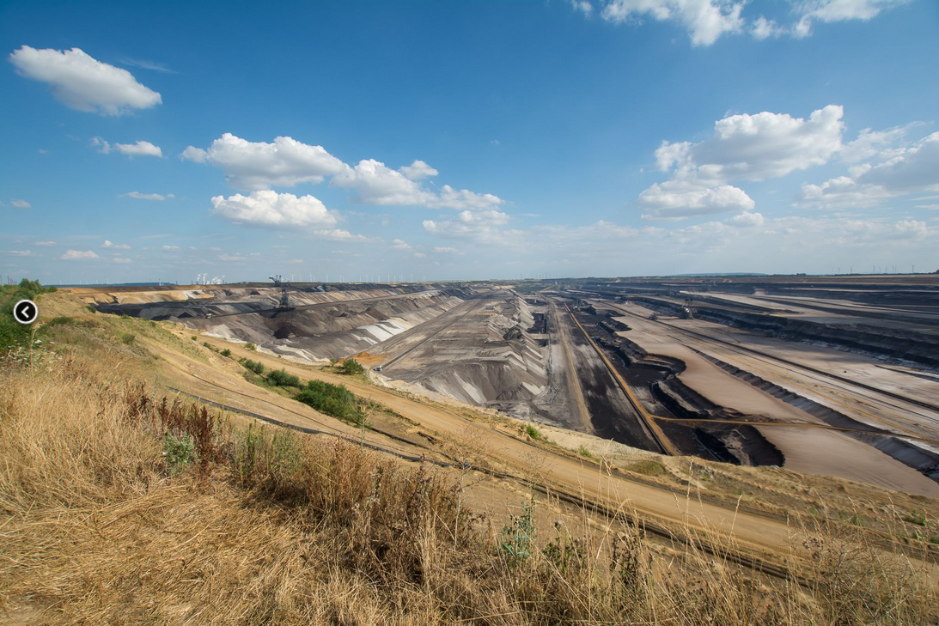
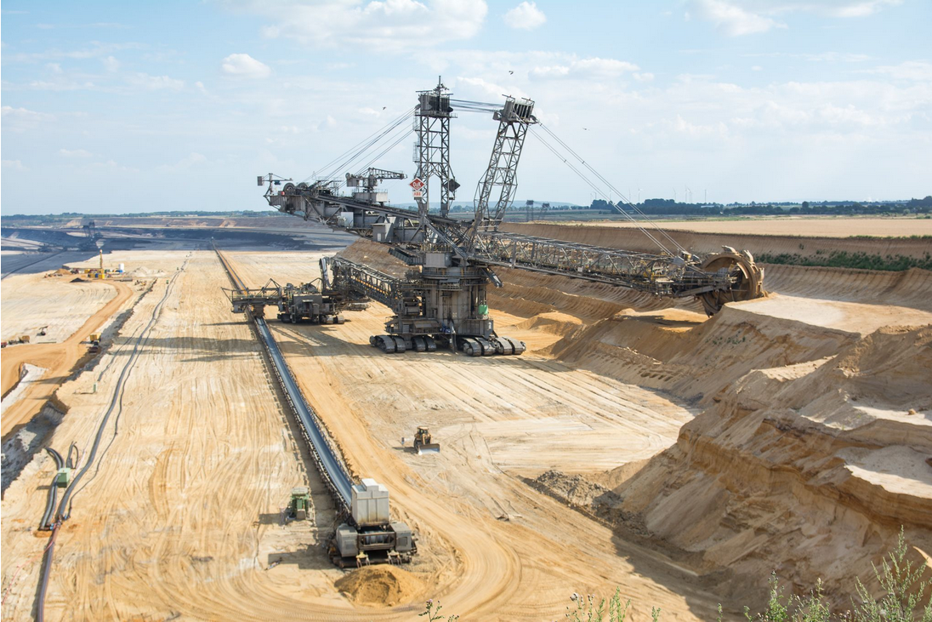
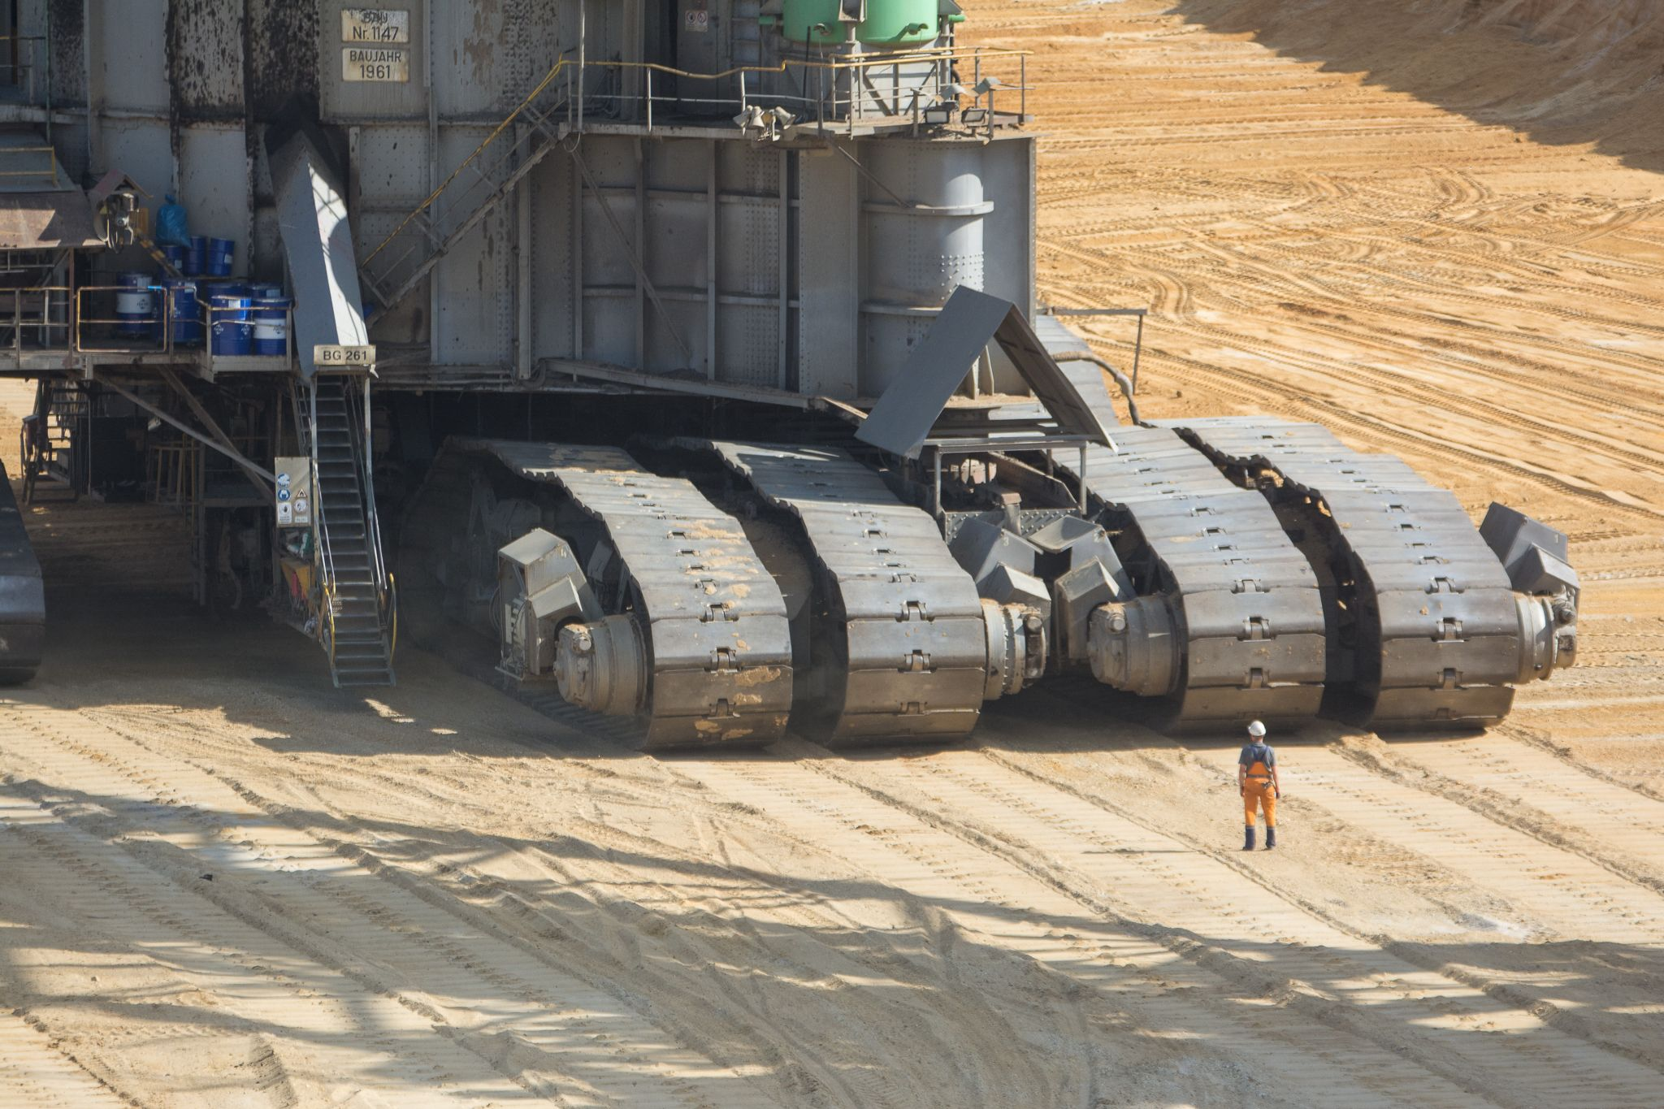
Surface Mining (coal)
30 min. busride

Slide 12
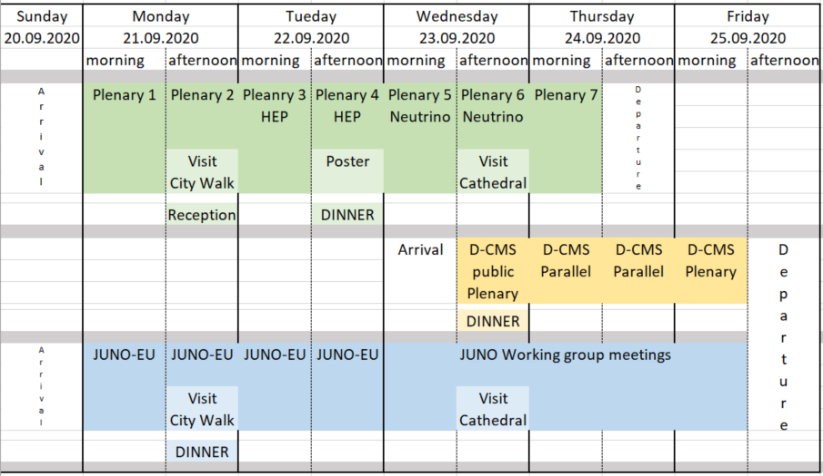
Timetable

Slide 13
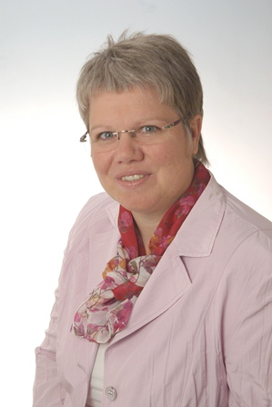
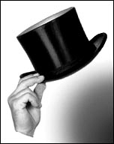
Ideas
Excursion(s): Cathedral, City Walk, Surface Mining (bus trip)
Stipends for students (increase general fee by 5%)
Satelite Meetings to increase participation
thanks
Claudia Cüster-Weiger

