Slide 1
Department of Physics, NTU
臺大物理系
National Taiwan University
and
Department of Physics
Paoti Chang
September 17th, 2019
The Symposium on Physics in collisions

Slide 2
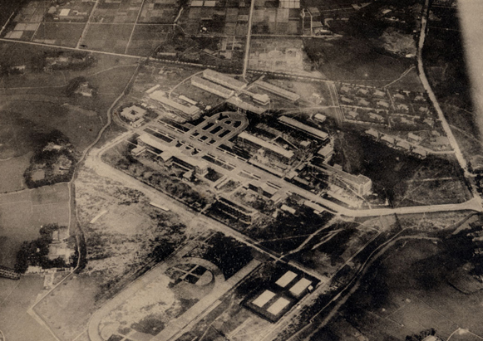
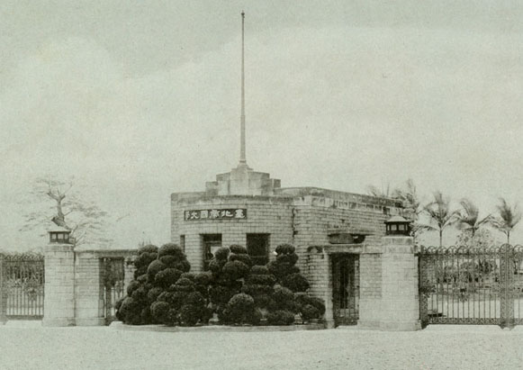
National Taiwan University
Predecessor: Taihoku Imperial University
− Funded in 1928 with 2 colleges and 59 students
Literature and Politics & Science and Agriculture
− Physics Lecture in Department of Chemistry
Panoramic view
Main gate

Slide 3
National Taiwan University
Established in November,1945
Six colleges, 22 departments and 179 students in 1st year
NTU now
− The most prestigious and largest in Taiwan
− 11 colleges, 56 departments, 112 graduate institutes
17000 undergrad. students, 15000 graduate students
− Occupied area 34000 ha, ~1% of the Taiwan land
− Education and Research
Department of physics was funded in 1946.

Slide 4
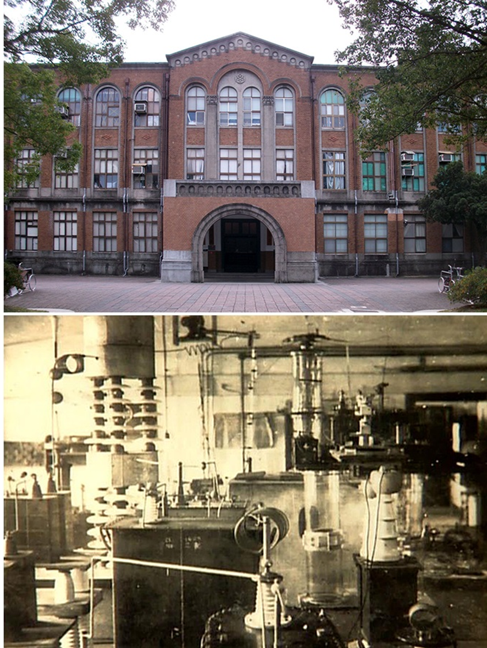
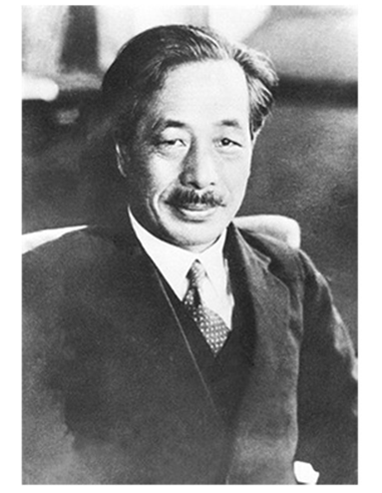
First Accelerator in Asia
July 25th,1934: first atom smash in Asia was done in the NTU campus
Professor
Arakatsu Bunsaku

Slide 5
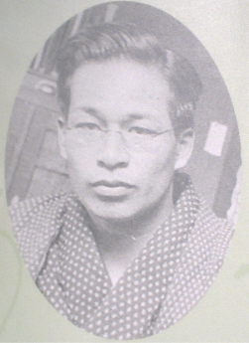
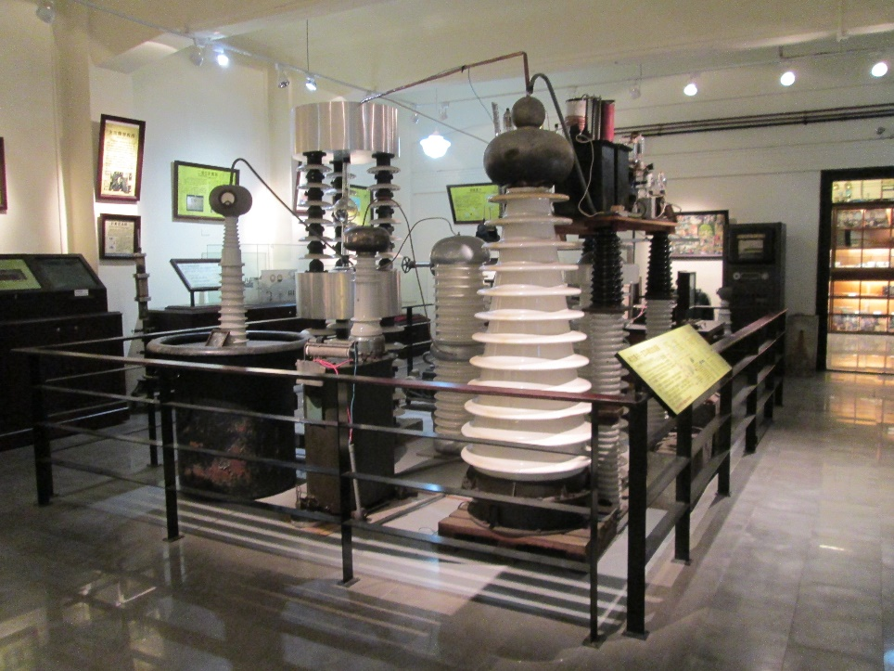
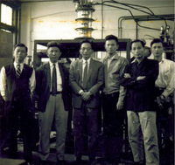
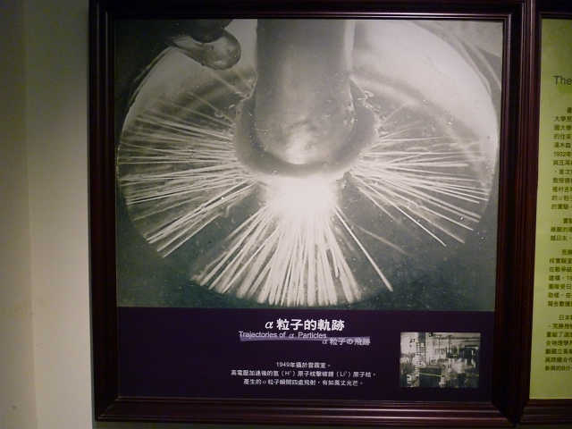
Rebuild the Accelerator in 1948
Ōta Yoritsune
太田賴常
Redo $H_{1}^{1 }+{Li}_{3}^{7}→2{He}_{2}^{4}$
Publish ~30 papers
Inspire $and educate students$
Heritage hall

Slide 6
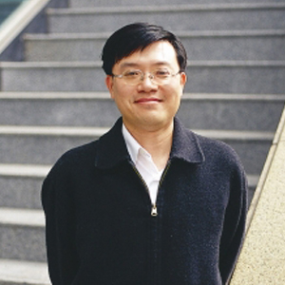
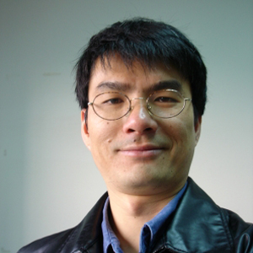
Chair/Director
Chair/Director
張寶棣 教授
Prof. Pao-Ti Chang
Associate Chair
陳俊瑋 教授
Prof. Jiunn-Wei Chen

Slide 7
History
1946
Department of Physics
undergraduate program
1969
Institute of Physics Ph.D. program
2001
Moved in to CCMS &
New Physics Building
2008
Graduate Institute of
Applied Physics
1960
Institute of Physics
master program
2003
Graduate Institute
of Astrophysics
2010
Astronomy-
Mathematics Building

Slide 8
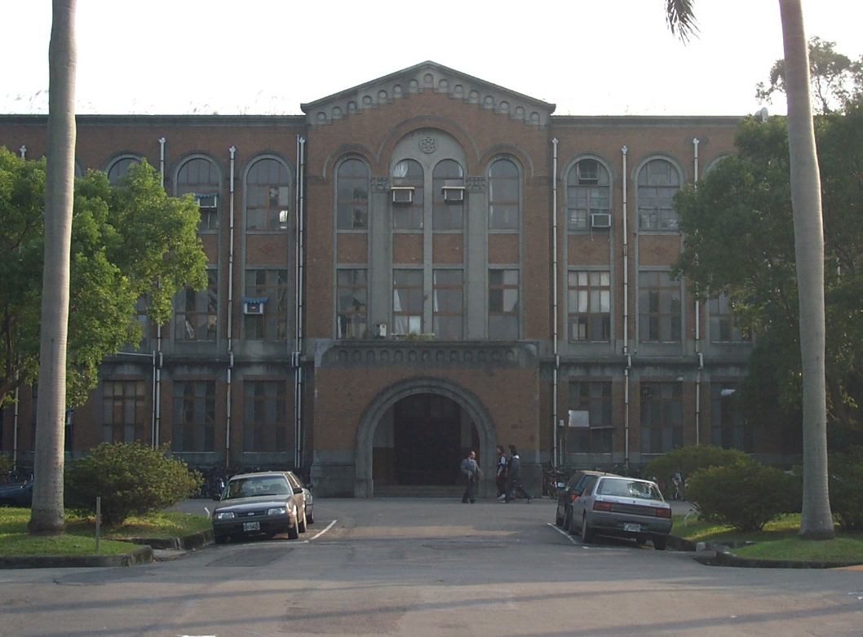
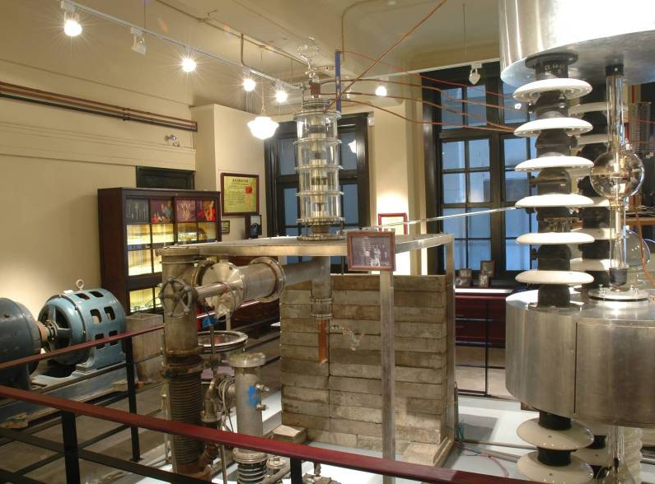
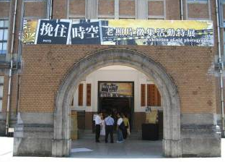
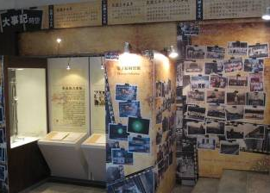
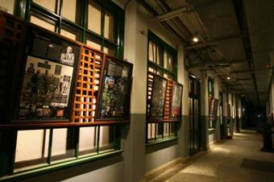
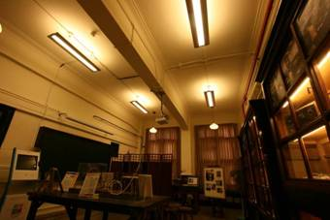
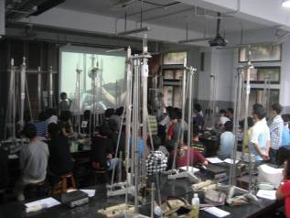
Bldg. No. 2 & Heritage Hall of Physics

Slide 9
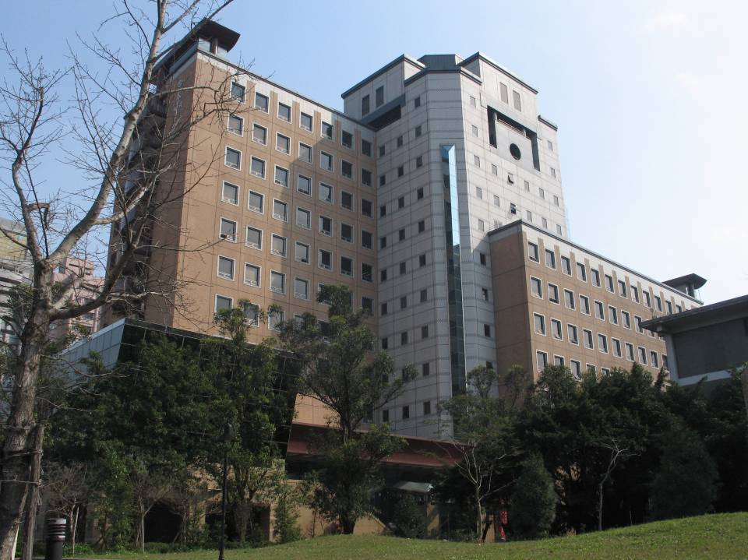
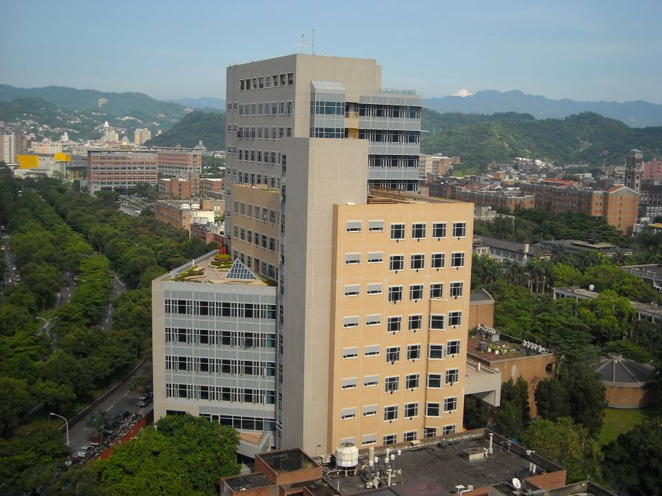
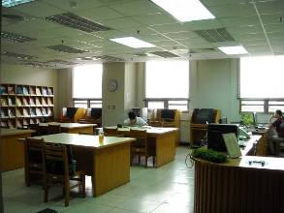
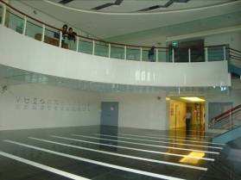
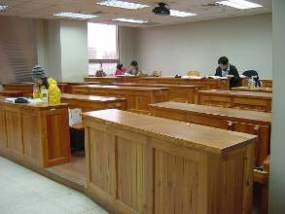
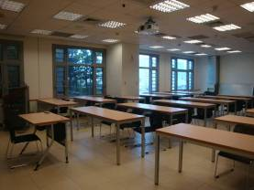
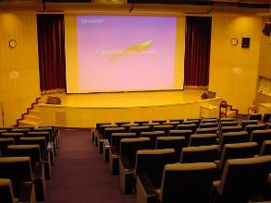
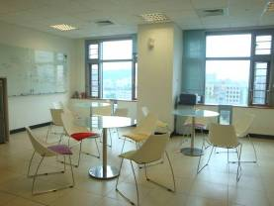
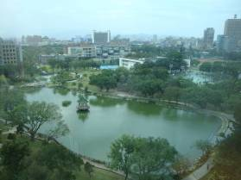
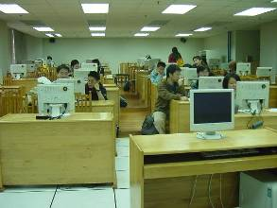
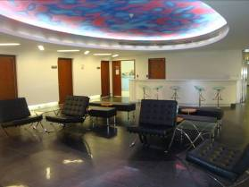
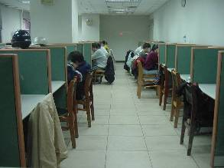
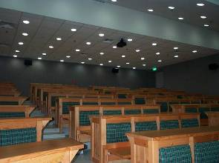
New Physics Bldg. and Astronomy-Mathematics Bldg.

Slide 10
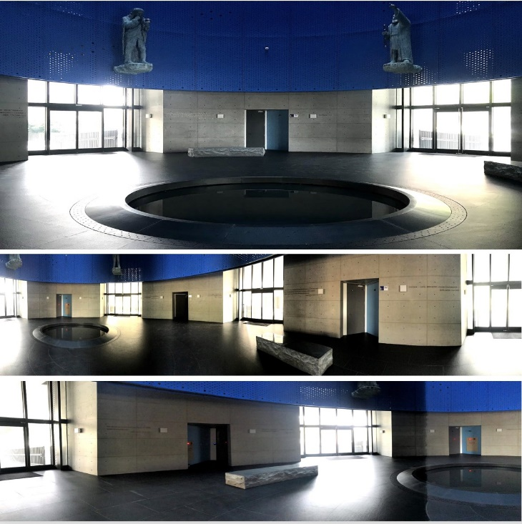
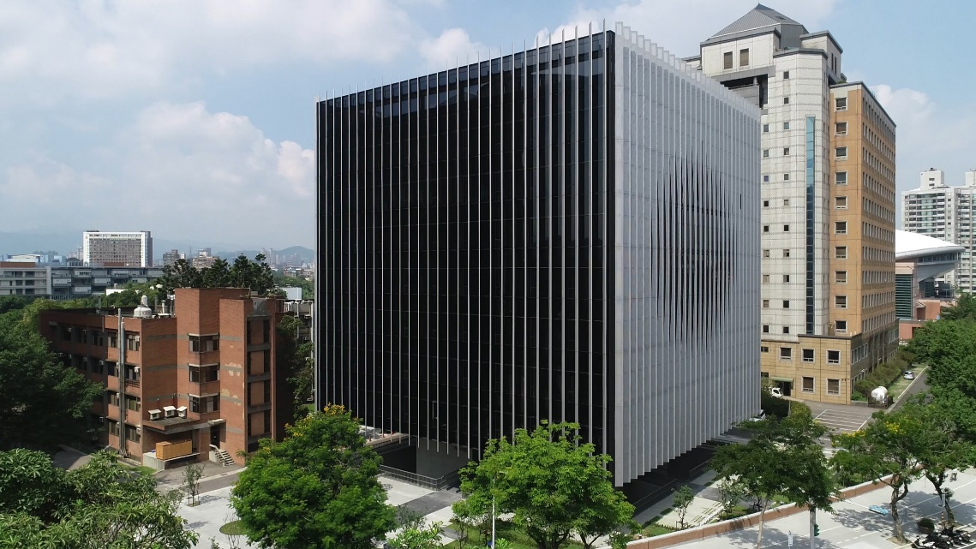
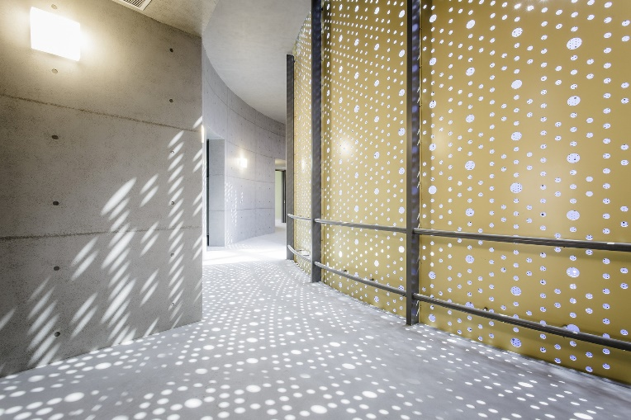
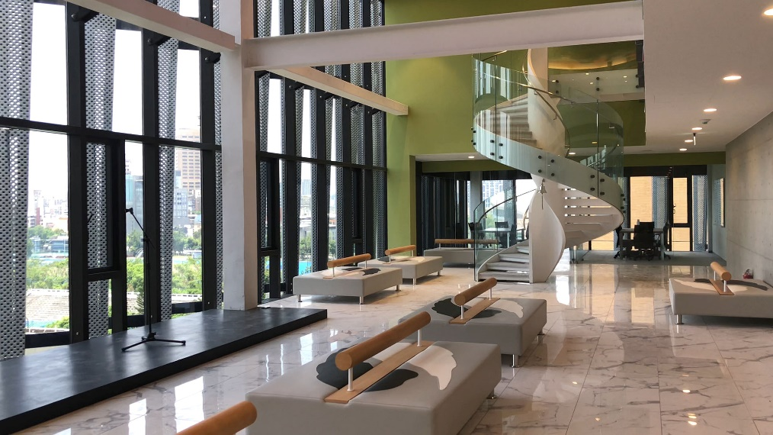
Leong Cosmology Building

Slide 11
Number of Students and Faculty
Years 班別 | 2014 | 2015 | 2016 | 2017 | 2018 | 2019
Undergraduate | 301 | 290 | 282 | 278 | 276 | 260
Master | 226 | 243 | 222 | 219 | 255 | 245
Doctoral | 163 | 145 | 144 | 139 | 147 | 139
Total （including International Students） | 690 | 678 | 648 | 636 | 678 | 644
Full-time Faculty | 49 | 48 | 48 | 46 | 47 | 45
Adjunct Professor | 14 | 14 | 10 | 8 | 7 | 9
Total | 63 | 62 | 58 | 54 | 54 | 54

Slide 12
International Students
 | Department Admission by | Physics | Astrophysics | Applied Physics
Foreign Students | Entrance Examination | 0 | 0 | 1
 | Exchange | 6 | 0 | 0
 | Individual Application | 4 | 0 | 1
 | School Recommendation | 1 | 0 | 0
 | Taiwan International Graduate Program (TIGP) | 14 | 0 | 0
Overseas Chinese Students | Entrance Examination | 0 | 2 | 0
 | Individual Application | 2 | 1 | 0
 | Registration and Placement | 2 | 0 | 0
 | School Recommendation | 5 | 0 | 0
Chinese Students | Exchange | 3 | 0 | 0
 | Individual Application | 9 | 0 | 0
Total |  | 46 | 3 | 2
Department By Country | Physics | Astrophysics | Applied Physics
China | 12 | 0 | 0
Hong Kong | 0 | 1 | 0
Macao | 3 | 2 | 0
Philippines | 1 | 0 | 0
Vietnam | 0 | 0 | 1
Malaysia | 6 | 0 | 0
Indonesia | 1 | 0 | 0
India | 12 | 0 | 1
Nepal | 1 | 0 | 0
Pakistan | 1 | 0 | 0
Japan | 2 | 0 | 0
Austria | 1 | 0 | 0
France | 1 | 0 | 0
Germany | 3 | 0 | 0
United States | 1 | 0 | 0
Costa Rica | 1 | 0 | 0
Total | 46 | 3 | 2

Slide 13
Scholarships
Sponsor | Name | Applicant | Degree | Duration | Coverage and Amount
Ministry of Education | MOE Taiwan Scholarship Program | Prospective Students | BS. MS. Ph.D. | 4 years 2 years 4 years | BS: Tuition waiver + TWD 15,000 /mon. Master and Ph.D.: Tuition waiver +TWD 20,000/mon.
Ministry of Foreign Affairs | MOFA Taiwan Scholarship Program | Prospective Students | BS. MS. Ph.D. | 4 years 2 years 4 years | TWD 30,000/mon. + round-trip ticket
Ministry of Science and Technology | MOST Taiwan Scholarship Program | Prospective Students | MS. Ph.D. | 2 years 3 years | TWD 30,000/mon.

Slide 14
Research Fields
Main Laboratories
．String Theory Group | ．TEM
．High Energy Physics Group | ．Semiconductor Laboratory
．Magnetism and Spintronics Laboratory | ．NanoMagnetism Laboratory
．Microscopic Biophysics and Biophotonics Laboratory | ．Photonics / Nano-Science & Technology Laboratory
．Superconductor and Low-Temperature Electronics Laboratory | ．Optoelectronics & Medical Physics and Biomedical Engineering Laboratory

Slide 15
Research Fields
High Energy Experiment
Prof. | Chang, Pao-Ti | Northeastern University (1994) | Belle II/Belle, CMS
Prof. | Hsiung, Yee Bob | Columbia University (1986) | JUNO, KOTO, Daya Bay
Prof. | Wang, Min-Zu | University of Iowa (1993) | Belle/Belle II
Prof. | Paganis, Stathes | University of Texas at Austin (1999) | CMS
Prof. | Chen, Kai-Feng | Ph. D., National Taiwan University (2005) | CMS
Assoc. Prof. | Lu, Rong-Shyang | Ph. D., National Taiwan University (2002) | CMS
Prof. | Hou, Wei-Shu | Ph. D., UC, Los Angeles (1985) | CMS, Theory

Slide 16
Research Achievement
Year | 2012 | 2013 | 2014 | 2015 | 2016 | 2017 | 2018 | 2019
Number of Faculty | 46 | 47 | 49 | 48 | 48 | 46 | 47 | 45
Number of SCI papers | 391 | 390 | 339 | 360 | 364 | 379 | 355 | 174
No. of Citation (Total) | 19,145 | 11,618 | 11,102 | 8,977 | 5,406 | 4,347 | 1,828 | 138
No. of Citation (Average) | 48.96 | 29.79 | 32.75 | 24.94 | 14.85 | 11.47 | 5.15 | 0.79
Impact Factor (Average) | 4.64 | 4.47 | 4.61 | 4.63 | 4.77 | 5.07 | 5.52
Number of SCI papers in the top 15% of the Impact Factor | 277 | 260 | 135 | 191 | 261 | 288 | 157
Number of SCI papers in the top 40% of the Impact Factor | 68 | 61 | 136 | 84 | 50 | 36 | 143
★ QS World University Rankings by Subject (Physics & Astronomy)：#51~100（2013 & 2014）,
#50（2015）, #47（2016）, #37（2017）, #34（2018）.
★ Number of SCI papers per year increase in recent years, since 2011 over 330 papers per year.
★ The average of impact factor in recent years is above 4.80, and the average number of papers
with impact factor in the top 15% category is more than 220.
(about 62% of the total papers in recent 5 years.)

Slide 17
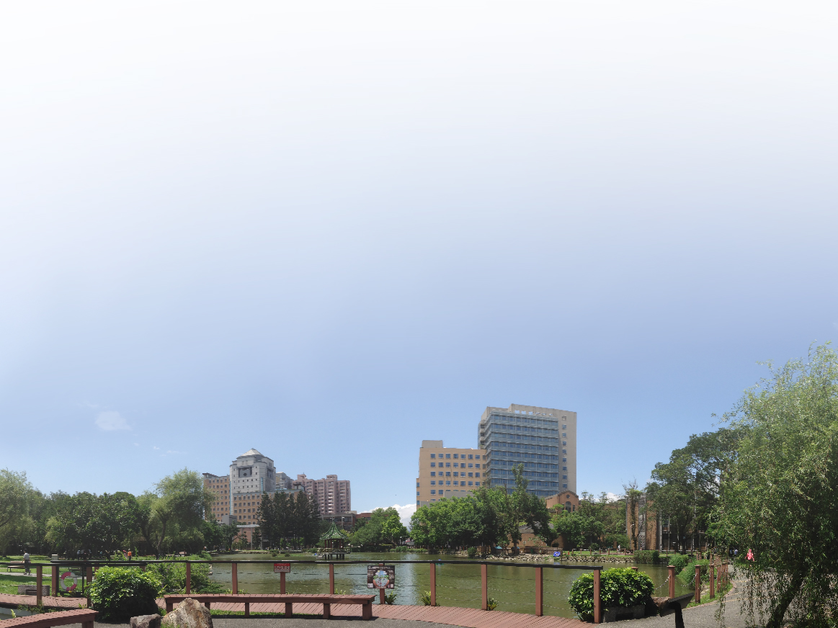
物理學系暨研究所
Department of Physics / Graduate Institute of Physics
天文物理研究所
謝謝
Graduate Institute of Astrophysics
應用物理研究所
Graduate Institute of Applied Physics
Thank you so much

